Slide 1
‘Fontes Anglo-Saxonici: The Challenges of Producing, Maintaining and Using Electronic Databases in the Twenty-First Century'
Christine Rauer and Mark-Jan Nederhof
cr30@st-andrews.ac.uk, mn31@st-andrews.ac.uk

Slide 2
Structure of this talk: 1) What is Fontes Anglo-Saxonici, its history; 2) latest developments and improvements, 3) the future of Fontes; remaining challenges; strategic planning.
Database of ‘written sources which were incorporated, quoted, translated or adapted anywhere in Old English or Latin texts which were written, or are likely to have been written, in Anglo-Saxon England, including those by foreign authors’
Collaborative research project, 1984-2007; senior / junior researchers; various UK universities
Scope: 1150 Anglo-Saxon texts sourced, over 500 in Old English and over 600 in Latin. These texts can be linked to nearly 1000 source texts, from Abbo to Wulfstan.
Older sourcing projects, e.g. J. D. A. Ogilvy, Books known to the English, 597-1066 (1967); A. S. Cook, Biblical Quotations in Old English Prose Writers, 2nd edn (1903)
Sources of Anglo-Saxon Literary Culture (SASLC, recently renamed SOEALLC); more book-based, US-based

Slide 3
Part 1) What is Fontes Anglo-Saxonici?
1999 web version of Fontes database first published (open access), Univ. of Oxford server
2002 CD-ROM version first published (for offline searches)
2018 web version suddenly taken offline by Oxford IT staff, for technical reasons: Microsoft Access no longer supported; database a security risk; research and AHRC /BA funding wasted?
CD-ROM problematic for Apple Mac users; few copies in circulation
Web version files obtained from Oxford in January 2020, for possible republication
Project floated to MSc student dissertation project supervisors in School of Computer Science
Mark-Jan Nederhof (supervisor) started work with MSc student Bryan Yick in April 2020

Slide 4
MSc Human Computer Interaction; modules include Information Visualisation, Digital Heritage and Preservation, User-Centred Interaction Design, Dissertation project
Multidisciplinary teams: communication, intuition, patience
Pandemic and other disruptions
Design: St Andrews brand? Oxford Blue…
2021 database innovations: predictive text; greater user-friendliness; less clutter; multiple types of devices; accessibility measures for disabled users; pinned entries
New Home of the Database: https://arts.st-andrews.ac.uk/fontes/search
Support website: https://www.st-andrews.ac.uk/~cr30/Mercian/Fontes

Slide 5
What can Fontes Anglo-Saxonici do?
Database searchable in two directions:
1) Starting point: target text (Anglo-Saxon text in Old English, Latin) → please find me its sources
2) Starting point: source → please find me the (Anglo-Saxon) target texts that use this source
‘Anglo-Saxon’: here, Old English PLUS Anglo-Latin

Slide 6
You can select an Anglo-Saxon text (whether Old English or Latin) and get a report of all the sources used for it, passage by passage, sometimes phrase by phrase, matched to precise locations in the texts
Which sources were used for the composition of Aldhelm’s Carmen ecclesiasticum 3?
Which sources were used for the composition of Blickling Homily 14?
You can pick a text used as a source, and ask for a list of all the Anglo-Saxon texts that used that source, and follow up the examples you’re interested in.
Which Anglo-Saxon authors (whether writing in Old English or Latin) used the biblical book of Job?
Which Anglo-Saxon authors (whether writing in Old English or Latin) used Gregory the Great’s Moralia in Iob?

Slide 7
Skewed towards sourceable texts: usually texts with Latin sources
Texts of an explicitly religious nature
For Old English: prose-heavy?
Entirely focused on surviving written materials
Currently focused on pre-Conquest target texts

Slide 8
Criticism directed at source study: e.g. Frantzen, Desire for Origins
Excessive focus on the origins of a text, vs the ‘derivative’ text?
Excessive focus on Latinate, religious, written material?
But: little biographical information on pre-Conquest authors: insights into their reading habits / literary environment crucial?
Consensus: knowing the sources of a text, not the whole story

Slide 9
Source identification dependent on identifying verbal parallels
se wæstm þines innoþes is gebletsad (Blickling Homily 1)
benedictus fructus ventris tui (Luke 1:42)
Easier within one language; much improved by electronic searching
Classification of source relationships, gradation
Use of sigla: S = single source
Certain=1 / probable=2 / possible=3 source: S1, S2, S3
Multiple sources (and / or): M1o, M1a, M2o, M3ao
Antecedent source, SA (e.g. Pliny, Historia naturalis; some biblical passages)
Analogue, SX
Sigla often overlooked by users in first version of database; more prominent in redesign

Slide 10
Part 2) Latest Developments and Improvements
The new database went live March 2021
MSc student Bryan Yick nominated for a national prize for Masters students
Press release, publicity, talks
Developments 2021-2: additional project staff, international advisory board
Future-proofing the database; new generation
Google analytics user statistics: most users UK-based; US 2nd; Germany, Italy, Spain
Primary aim achieved: database online; secondary aim: fix snags, improve functionality
6 March: Mark-Jan’s latest set of works completed

Slide 11
Redundancies and Inconsistencies
Some texts represented twice, once as source and once as target
Different but overlapping information
Inconsistent spelling
Alfred the Great vs Alfred
Gregory’s Regula Pastoralis (OE) vs Gregory the Great, The Pastoral Care
Solution: one table contains both source and target texts, in uniform representation

Slide 12
Data Integrity and Linkage
Bibliographies as flat text:
Chaplais 1966a, 21-2; Keynes 1994b, 52c
Inconsistent labels with respect to list of references
Solution:
Structured representation:
{label: “Chaplais 1966a”, pages: “21-2”} and {label: “Keynes 1994b”, pages: “52c”}
Hyperlinks

Slide 13
Adding More Data
Database frozen since 2007
Adding data involves manually checking integrity and adding IDs for sorting
Inconsistent labels with respect to list of references
Solution:
Web-based interface, for contributors and editor
Guarantees integrity
Automatic sorting

Slide 14
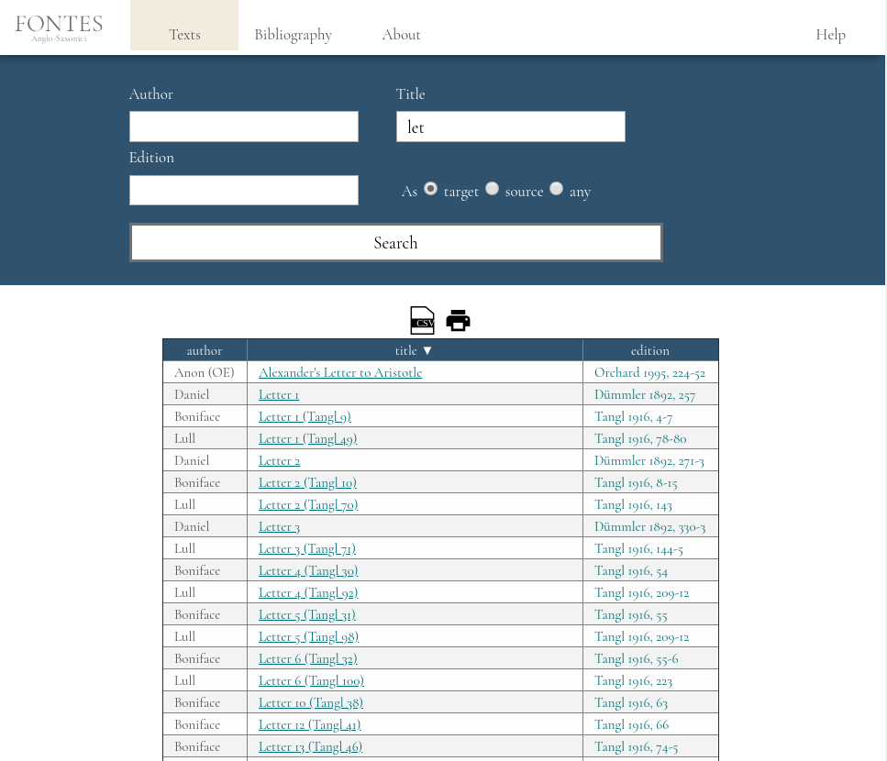

Slide 15
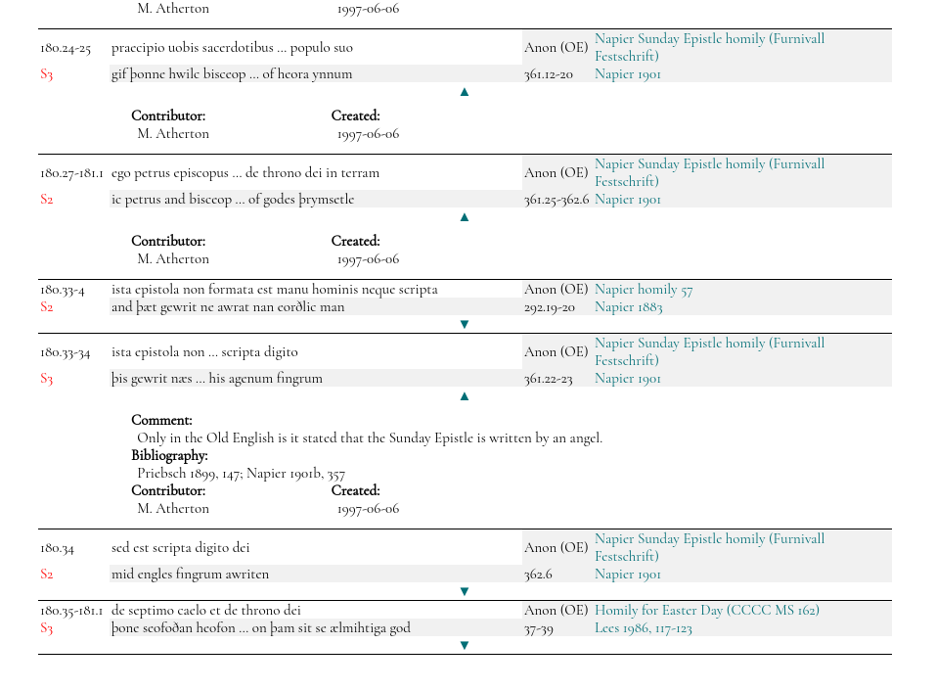

Slide 16
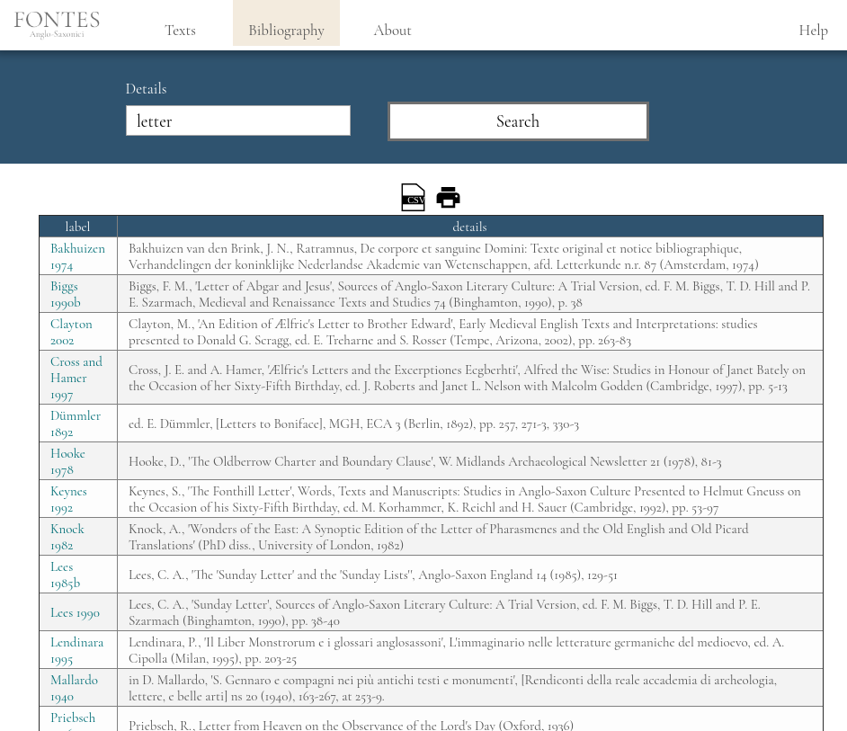

Slide 17
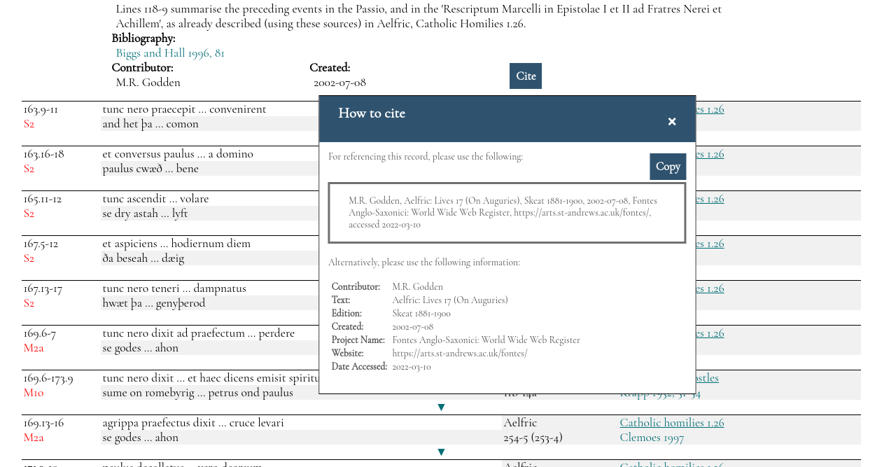

Slide 18
Part 3) The Future of the Database
Funding bodies not interested in re-publication; interested in growth, new data
Funding applications for growth: new data / new insights from old data / new functionality
New from 2022 onwards: enabling database for updating; queue of entries for upload
Slow but low-cost! Open call for contributors in 2022
What would it take to complete the database? Funding. Fast but high-cost.
What kind of texts still missing? What kind of genres incomplete: Homilies; poetry; penitentials; grammatical texts; medical texts; analogues; charters
= growing the database in terms of adding new data

Slide 19
Globality in medieval studies: Fontes charts a vast literary network; visualisation
Insular vs non-insular authors? Transnational literature
Levels of duplication and intertextuality, textual overlap
Source Statistics: S1 (17530), SA1 (2332), S2 (2083), M1a (2101)
Parallels with modern intertextuality: ‘plagiarism’; copyright; competitive assessment, commerce
The internet: unacknowledged borrowing and copying
Intent to deceive?
Pseudepigraphy (falsely attributed works); contract cheating
= growing the database in terms of adding new results and insight from old data

Slide 20
Role played by the younger generation
requirements:
interest in text analysis
language learning (Latin and Old English)
awareness that an interest in the global Middle Ages was central to Fontes Anglo-Saxonici right from the start
Ability to use textual detail to form new insights in intellectual history (text production, location and movement of authors and texts, networks)
Timeless data; will be relevant in many more scholarly contexts over the next few decades

