Slide 1
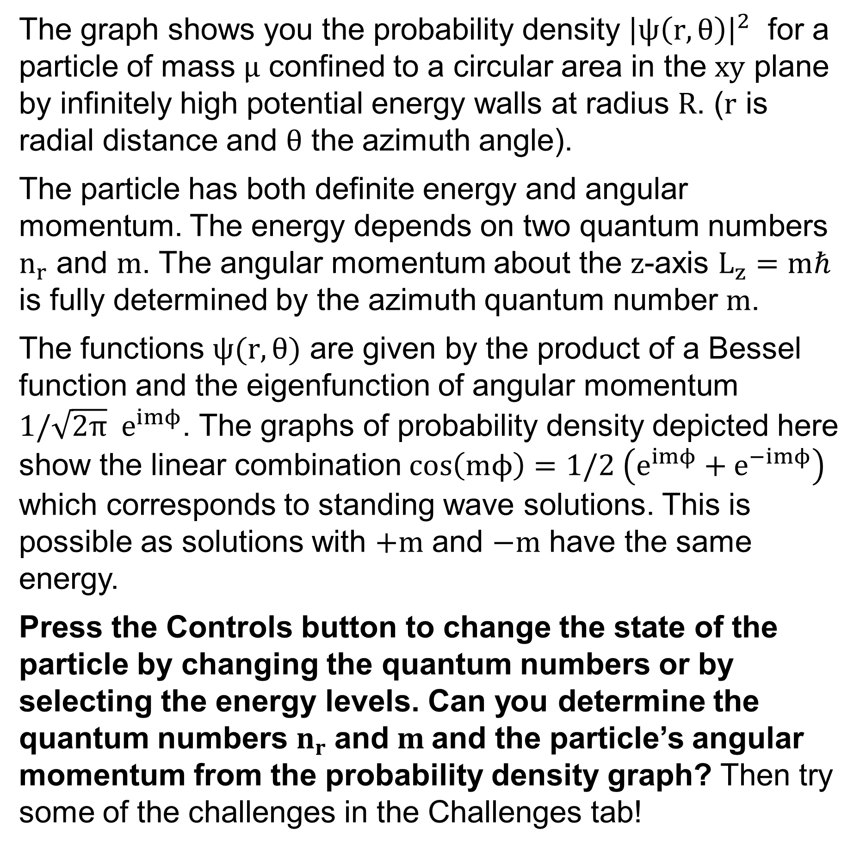
The graph shows you the probability density ${\left|ψ\left(r,θ\right)\right|}^{2}$ for a particle of mass $μ$ confined to a circular area in the $xy$ plane by infinitely high potential energy walls at radius $R$. ($r$ is radial distance and $θ$ the azimuth angle).
The particle has both definite energy and angular momentum. The energy depends on two quantum numbers $n_{r}$ and $m$. The angular momentum about the $z$-axis $L_{z}=mℏ$ is fully determined by the azimuth quantum number $m$.
The functions $ψ(r,θ)$ are given by the product of a Bessel function and the eigenfunction of angular momentum $1/\sqrt{2π} e^{imϕ}$. The graphs of probability density depicted here show the linear combination $\cos\left(mϕ\right)=1/2 \left(e^{imϕ}+e^{−imϕ}\right)$ which corresponds to standing wave solutions. This is possible as solutions with $+m$ and $−m$ have the same energy.
Press the Controls button to change the state of the particle by changing the quantum numbers or by selecting the energy levels. Can you determine the quantum numbers $n_{r}$ and $m$and the particle’s angular momentum from the probability density graph? Then try some of the challenges in the Challenges tab!

Slide 2




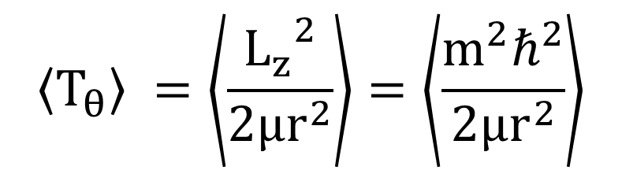
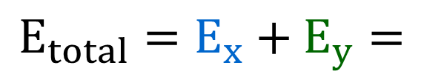





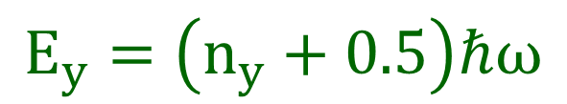




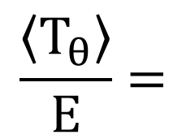


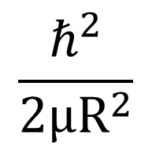


(4,4)
(4,3)
(4,2)
(3,4)
$$(n_{r},m)$$
(4,1)
(3,3)
(4,0)
$$m$$
(3,2)
$$μ$$
$$E=$$
(2,4)
$${\left|ψ\left(x,y\right)\right|}^{2}$$
$$R$$
(3,1)
(2,3)
$$\frac{ℏ^{2}}{2μR^{2}}$$
$$E_{3}$$
$$E_{4}$$
$$E_{5}$$
$$E_{x}$$
$$\frac{\left\langle T_{θ}\right\rangle }{E}=$$
$$E_{y}$$
(3,0)
$$n_{r}$$
(2,2)
$$E_{x}=\left(n_{x}+0.5\right)ℏω$$
(1,4)
$$\left\langle T_{θ}\right\rangle$$
$$E_{y}=\left(n_{y}+0.5\right)ℏω$$
(2,1)
(1,3)
$$\left\langle T_{θ}\right\rangle =\left\langle \frac{{L_{z}^{}}^{2}}{2μr^{2}}\right\rangle =\left\langle \frac{m^{2}ℏ^{2}}{2μr^{2}}\right\rangle$$
$$E_{total}=E_{x}+E_{y}=$$
(2,0)
(1,2)
$$E_{x}= ℏω$$
(0,4)
$$L_{z}=mℏ$$
$$E_{y}= ℏω$$
(1,1)
(0,3)
(1,0)
(0,2)
(0,1)
(0,0)

Slide 3
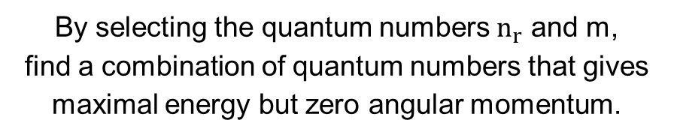
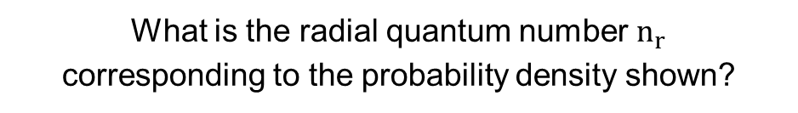
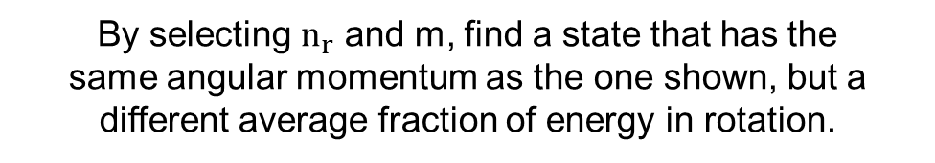
What is the radial quantum number $n_{r}$ corresponding to the probability density shown?
What is the azimuth quantum number m corresponding to the probability density shown?
By selecting the quantum numbers $n_{r}$ and m, find a combination of quantum numbers that gives maximal energy but zero angular momentum.
By selecting $n_{r}$ and m, find a state that has the
same angular momentum as the one shown, but a different average fraction of energy in rotation.

Slide 4

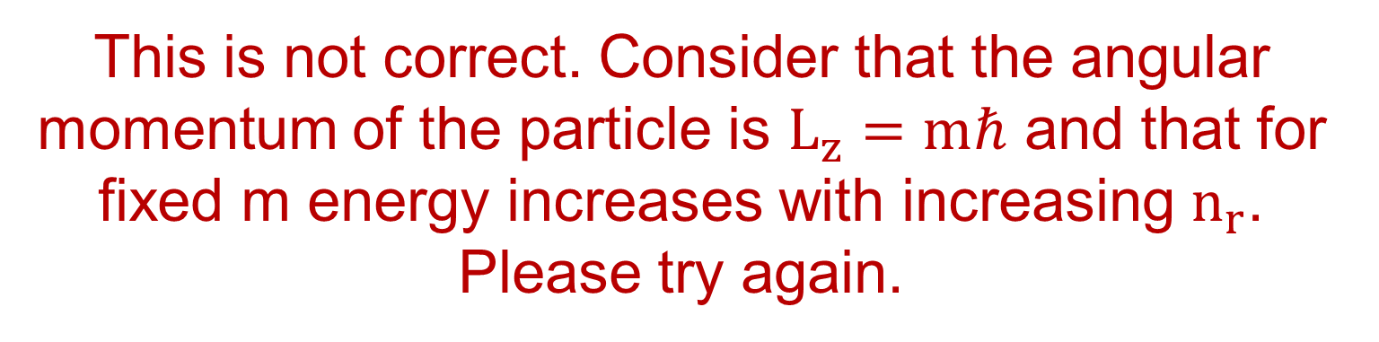
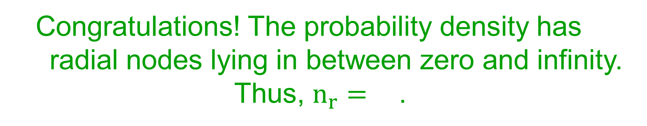
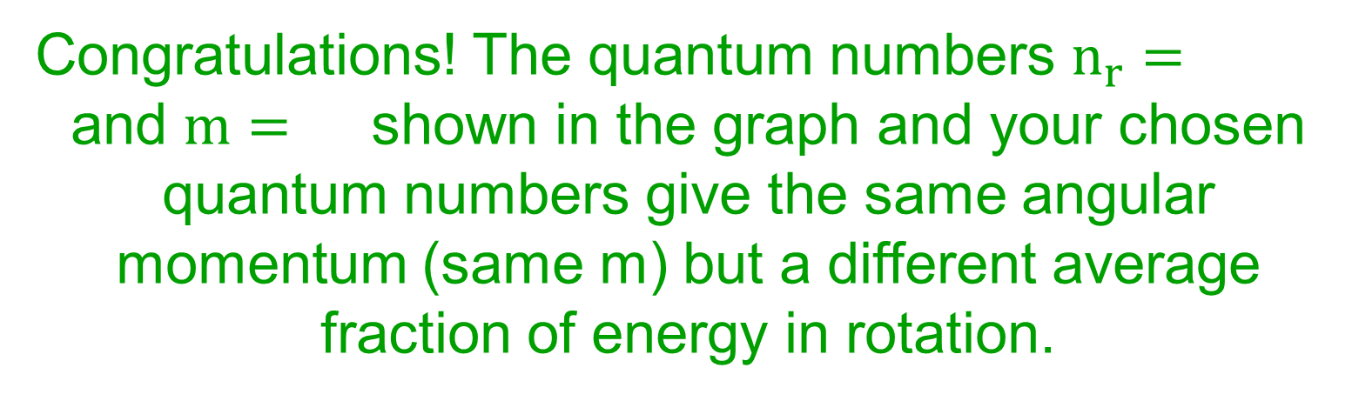
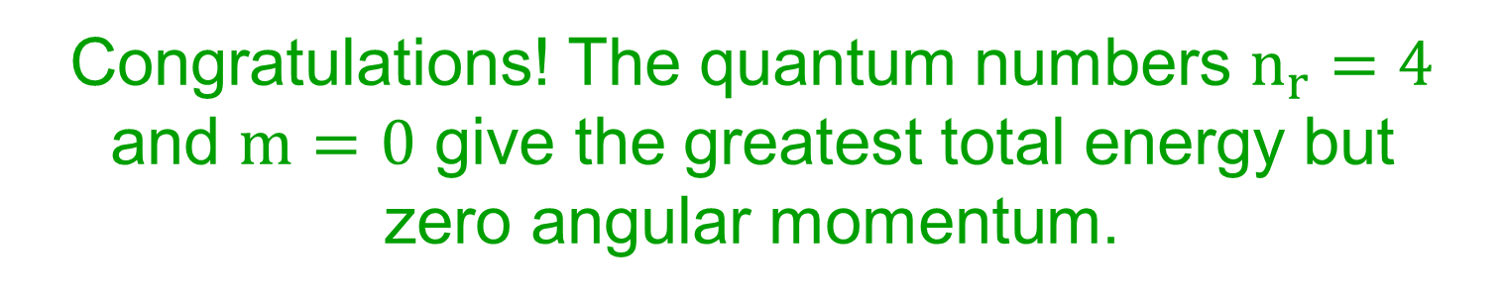
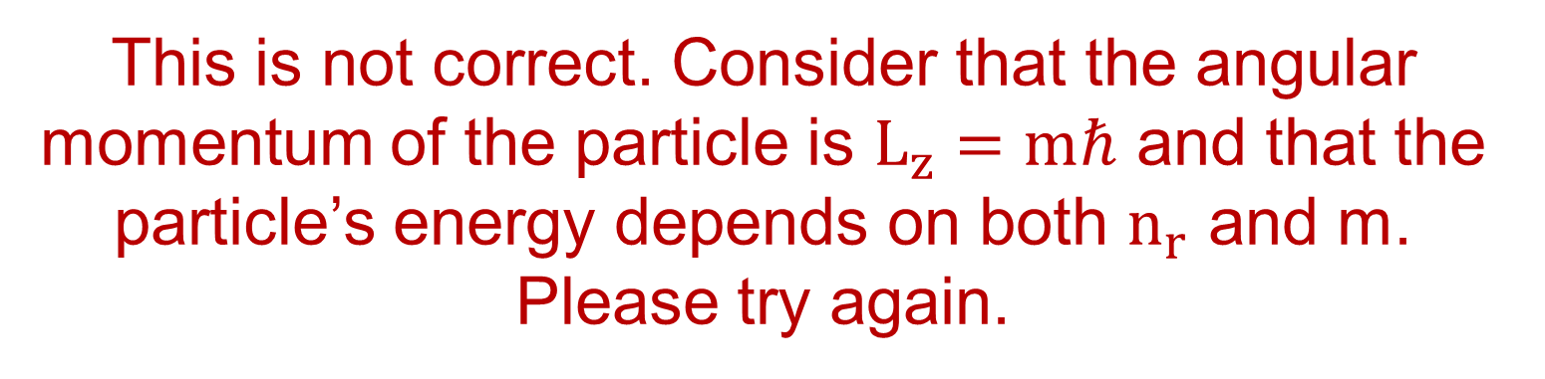
This is not correct. Consider that the angular momentum of the particle is $L_{z}=mℏ$ and that for fixed m energy increases with increasing $n_{r}$. Please try again.
Congratulations! The probability density has
radial nodes lying in between zero and infinity. Thus, $n_{r}=$ .
Congratulations! The probability density has
nodes along the azimuth direction.
Thus, $m=\frac{}{2}=$ .
This is not correct. Consider that the angular momentum of the particle is $L_{z}=mℏ$ and that the particle’s energy depends on both $n_{r}$ and m. Please try again.
Congratulations! The quantum numbers $n_{r}=4$ and $m=0$ give the greatest total energy but
zero angular momentum.
Congratulations! The quantum numbers $n_{r}=$
and $m=$ shown in the graph and your chosen quantum numbers give the same angular momentum (same m) but a different average fraction of energy in rotation.
Please choose values for both $n_{r}$ and $m$.

Slide 5
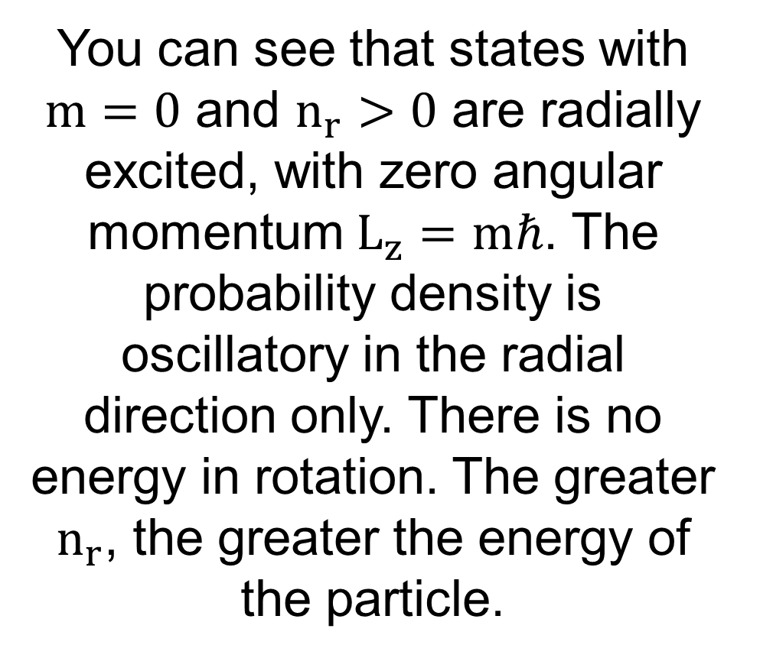
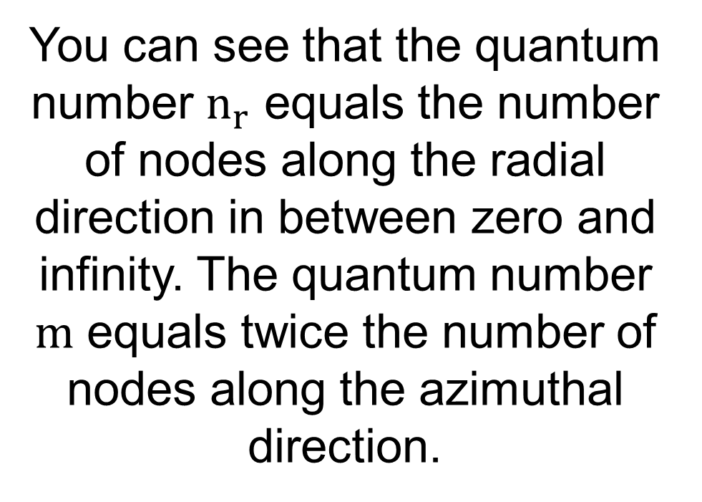
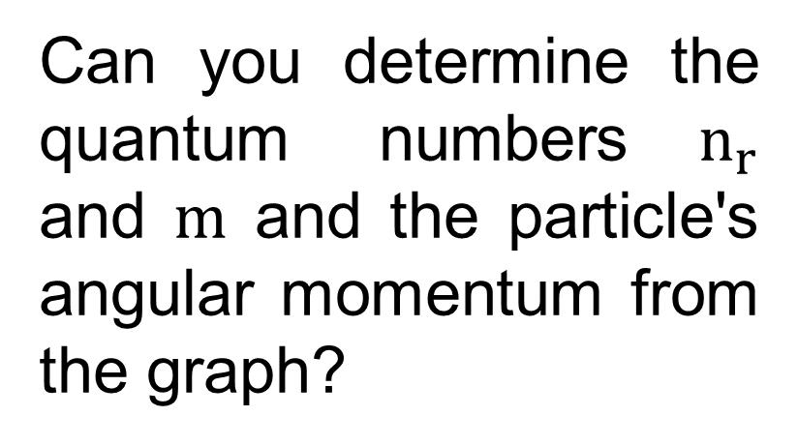
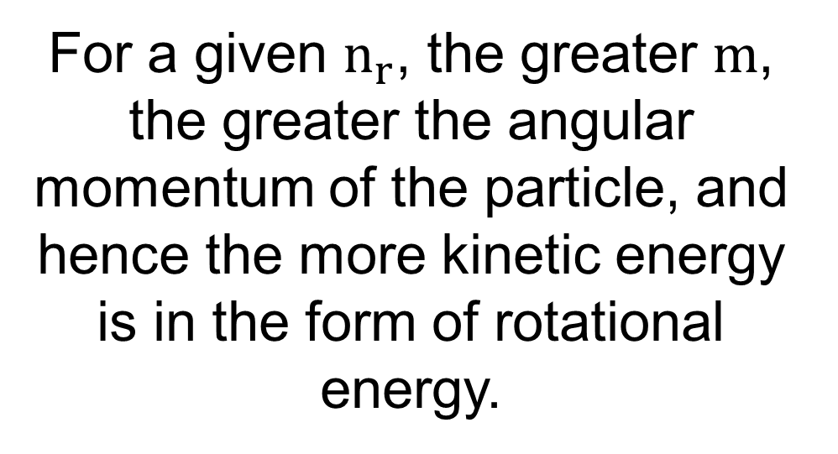
You can see that the quantum number $n_{r}$ equals the number of nodes along the radial direction in between zero and infinity. The quantum number $m$ equals twice the number of nodes along the azimuthal direction.
Can you determine the quantum numbers$n_{r}$ and $m$ and the particle's angular momentum from the graph?
You can see that states with $m=0$ and $n_{r}>0$ are radially excited, with zero angular momentum $L_{z}=mℏ$. The probability density is oscillatory in the radial direction only. There is no energy in rotation. The greater $n_{r}$, the greater the energy of the particle.
For a given $n_{r}$, the greater $m$, the greater the angular momentum of the particle, and hence the more kinetic energy is in the form of rotational energy.

