Slide 1
Assessing structure: developing a shared meta-language
Jenifer Spencer Freelance Materials Writer and Language Consultant

Slide 2
Assessing Fair Isle Knitting

Slide 3
Aims of the Workshop Deconstructing structure?
What elements of structure are we assessing?
What typical metalanguage do we use in these criteria?
Does it identify specific organising principles and the way they are manifested as textual or language features ?
Can we identify some useful metalanguage that could be shared with students in both criteria and in teaching and feedback?

Slide 4
Some Typical Metalanguage
Arguments Coherence
Paragraphs
Topic sentences
Logical....

Slide 5
What does ‘logical’ mean?
All arguments containing logical fallacies are bad arguments.
Therefore: all arguments without logical fallacies are good and convincing.
All Xs are blue.
Y is an X. Therefore Y is blue.
Actually .........
Academics spend most of their time deciding if Y is an X in the first place!
Logic is not what convinces people: sound evidence relative to their state of knowledge will.
Giving reasons is not a logical activity.

Slide 6
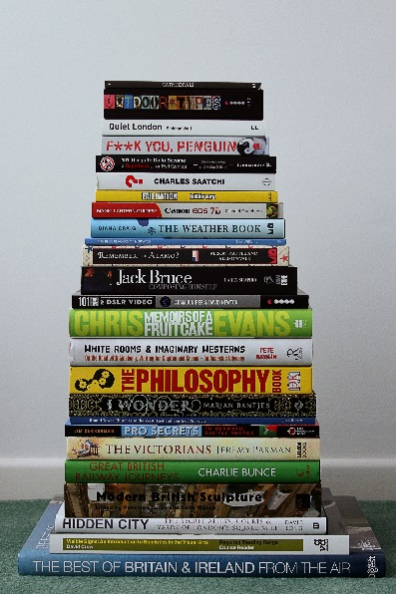
What is the logical way to organise a pile of books?
The way that suits your purpose!

Slide 7
What is coherence?
“... there has been relatively little research to describe features that may contribute to or detract from coherence in student writing...” (Basturkman and von Randow, 2014)
“Coherence is not directly a property of text in the way that cohesion is understood to be... The ability to make sense of a text derives partly from what the reader brings to the text, such as background knowledge of the topic expectations and schematic knowledge of how texts are typically organised, either in terms of general text patterns (rhetorical or coherence relations), text types or genres. The organisation of ideas and information plays a key role... ” (ibid. p15)

Slide 8
Organising principles - for the reader: me speaking to you
THEMATIC
Given (familiar) → new
Here’s what I am going to talk about and this is what I am going to say about it.
Builds up increasingly complex chains of noun phrases to carry the theme forward and develop it. (Enables the reader to skim the text)
General → Specific
Voice- a general claim followed by explanation/ elaboration/ reasons/ support/ significance.
Genre organisation (expected)

Slide 9
What is coherence?
“... there has been relatively little research to describe features that may contribute to or detract from coherence in student writing...” (Basturkman and von Randow, 2014)
“Coherence is not directly a property of text in the way that cohesion is understood to be... The ability to make sense of a text derives partly from what the reader brings to the text, such as background knowledge of the topic expectations and schematic knowledge of how texts are typically organised, either in terms of general text patterns (rhetorical or coherence relations), text types or genres. The organisation of ideas and information plays a key role... ” (ibid. p15)

Slide 10
Assessing the pattern or the jumper?

Slide 11
FAIR ISLE KNITTING PATTERNS
FUNCTIONAL FRAMEWORKS
Knowledge Telling
Description
Definition processes and procedures
Explanation, connecting
Comparison, Effect and Cause, Change and Development
Persuading
Problematizing→ Problem →solution.
Evidence→ conclusions →Argument
Knowledge transforming

Slide 12
Structure- not a thing but a dynamic process?
“Students need the linguistic resources to enable them to:
... Manage the movement up and down between high level abstractions and generalisations and low level details and particulars...
Organise a text by patterns of lexis and grammar at text, paragraph and sentence level, including macrotheme, hypertheme and clause theme and within paragraphs at general and particular levels”
(Donohue, 2012)
If that’s not FAIR ISLE KNITTING, what is?

Slide 13
Language for assessment of organising principles
Reader awareness and orientation
Thematic
General→ specific , given to new
Genre related
Manifestations (features)
Showing relationships of information and ideas
Functional

Slide 14
References
Alexander, O., Argent, S. and Spencer, J., 2008. EAP Essentials, a Teacher’s Guide (Chapter 2). Reading: Garnet Education.
Basturkman, H. and von Randow, I. (2014). Guiding the reader (or not) to recreate coherence: observations on postgraduate writing in an academic argumentative writing task. Journal of English for Academic Purposes 16 14-22.
Donohue,J. (2012) Using systemic functional linguistics in academic writing development: An example from film studies. Journal of English for Academic Purposes 11 4-16
Background reading: Bloor, T and Bloor,M. (1995).The functional Analysis of English. London: Arnold

Slide 15
The End
(Genre expectation)
jenifer.spencer1@btinternet.com

