Slide 1
Assessing student writing practices on Lancaster University’s EAP (Study Skills) Programme Bimali Indrarathne, Tasneem Sharkawi, Johnny Unger Lancaster University

Slide 2
Overview
Comparison of the writing Can Dos of Lancaster University’s EAP (Study Skills) Programme, Can Dos in the IELTS writing descriptors and the Can Dos of the CEFR.
Other skills included in the EAP Can Dos.
Discussion of sample tutor feedback.
Notes:
J

Slide 3
Expectations
Visa requirement: “at least level B1 on the Common European Framework of Reference” (www.gov.uk, 2014)
Some institutions accept the results of external tests – IELTS, TOEFL, while some require students to take an internal test as well (Banerjee & Wall, 2006)
Intensive EAP courses in particular are designed to improve the IELTS score of students by one band (Gillett, 2011) or more.
Notes:
J

Slide 4
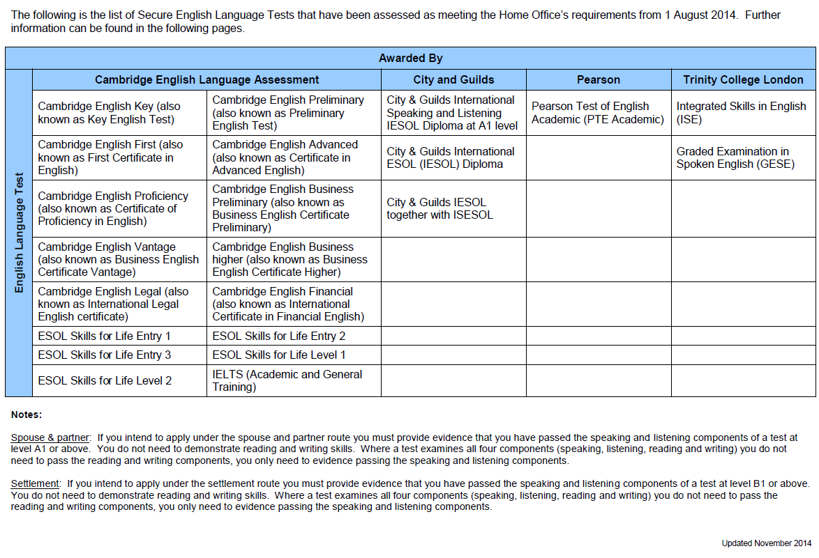
Approved tests (until April 2015)

Slide 5
IELTS vs EAP assessment
IELTS and university essays – some resemblance, many differences (Moore & Morton, 2005)
Preference of EAP assessment at universities over IELTS - criteria is more compatible with the university assessment criteria, information can be more useful for admitting departments (Banerjee & Wall, 2006)
A study reveals that “the language ability of the IELTS group of students was consistently lower across EAP skills and levels.” (Fox, 2009, p. 38)
Another study reports that a three month presessional course could raise the overall IELTS band from only half a band (Elder & O’Loughlin, 2003)
Notes:
B

Slide 6
Lancaster University EAP Programme

Slide 7
Brief overview
a 4 week programme
Ca. 250 students: undergraduates and postgraduates
20 + tutors
Assessing writing
A set of Can Do statements
Accessible to students through Self Assessment Questionnaire and Final Assessment Checklist
Three essays

Slide 8
Comparison of Can Dos

Slide 9
EAP Can Do 1: Can understand assignment instructions.
IELTS Writing Task 1 | IELTS Writing Task 2 | CEFR
covers all requirements of the task sufficiently Band 8 | sufficiently addresses all parts of the task Band 8 | Can cope with writing down changes to arrangements given by teachers and lecturers. B2
fully satisfies all the requirements of the task Band 9 | fully addresses all parts of the task Band 9 | Can write down details of all standard arrangements for assignments to be handed in, etc., as given verbally or in notices by teachers and lecturers. B2
Notes:
B

Slide 10
EAP Can Do 3: Can accurately explain others’ ideas using own words (i.e. do summarising / paraphrasing).
IELTS Writing Task 1 | IELTS Writing Task 2 | CEFR
None | None | Can select the most salient and relevant ideas and represent them clearly and briefly. C1
None | None | Can paraphrase or summarize effectively. Can make useful notes from written sources, capturing abstract concepts and relationships between ideas. C2

Slide 11
EAP Can Do 5: Knows how to properly acknowledge sources: when paraphrasing, when quoting directly.
EAP Can Do 6: Can construct a list of references (bibliography) correctly.
IELTS Writing Task 1 | IELTS Writing Task 2 | CEFR
None | None | None
None | None | None
None | None | None
Notes:
B

Slide 12
How do our tutors assess these Can Dos?

Slide 13
Essay titles and Tutor Feedback Forms
Essay 1
Use information from the Leslie and Smith (2004) survey to account for the difficulty that new overseas students in Western universities encounter in their pursuit of academic success. Refer also to Hawkes (2014) to support some of the points you make.
Essay 2
Wal-Mart claims that it benefits local communities when it enters a new area. Evaluate this claim, referring to textual and audio-visual information that you have encountered.
Essay 3
Present a short critical response to the issues raised by Sowden (2005) in his paper, ‘Plagiarism and the culture of multilingual students in higher education abroad’. In your response you should support or challenge some of Sowden’s arguments using evidence.

Slide 14
How well does tutor feedback demonstrate that Can Dos are assessed appropriately and adequately?
Notes:
T

Slide 15
EAP Can Do 4: Can organise writing in appropriate sections, using paragraphs and linking between them.
Tutor feedback
You explain the purpose of the essay well, however, your introduction does not have a background/context, so it begins rather abruptly. Your routemap is too general (the specific categories which you developed in the course of last week would have helped here).
You have clear paragraphs, but the body of your essay is not linked very well (no signposting at the beginning of paragraph 2, and wrong phrase at the beginning of paragraph 3). Have a look at GB p. 19 for examples of linking expressions.
IELTS: skilfully manages paragraphing (9)
CEFR: The essay shows a good organizational structure, which enables the message to be followed without much effort. (C2)
Notes:
T

Slide 16
EAP Can Do 7: Can produce writing that is easily comprehensible in terms of grammar and vocabulary.
IELTS: uses a wide range of vocabulary with very natural and sophisticated control of lexical features; rare minor errors occur only as ‘slips’, uses a wide range of structures with full flexibility and accuracy; rare minor errors occur only as ‘slips’. (9)
CEFR: Can write an essay that shows an ability to communicate with few difficulties for the reader. Is unlikely to make more than occasional errors of grammar, vocabulary or punctuation. (C2)
Notes:
T

Slide 17
EAP Can Do 7: Can produce writing that is easily comprehensible in terms of grammar and vocabulary.
Tutor feedback
Some of your language is well-expressed, using good phrases and vocabulary. At other times, the way you express your ideas could be improved. Make an effort to write your ideas as clearly as possible. For example, you sometimes omit the verb from your sentences. This makes it very difficult for your reader to understand what you mean. Read through your work before you submit it to make sure that you have expressed yourself well. There are a few areas of grammar that need your attention: the use of gerunds, the use of prepositions and articles, tense use and punctuation. Work on these areas by yourself, using the grammar books in the classroom.
Notes:
T

Slide 18
Summary
The comparisons reveal how the EAP Can Dos are on a par with IELTS bands 8 and 9 and CEFR levels C1 and C2 even though the required IELTS band for the university is between 6 and 7.
EAP Can Dos include skills such as referencing which are not included either in IELTS or CEFR.
Discussion of sample tutor feedback shows how the course assesses whether students can do our Can Dos.
Notes:
J

Slide 19
Implications
What does this say about the role of IELTS in university entry language assessment?
Are we being too hard on our EAP students or are the requirements set too low?
Notes:
J

Slide 20
References
Banerjee, J., & Wall, D., (2006). Assessing and reporting performances on pre-sessional EAP courses: Developing a final assessment checklist and investigating its validity. Journal of English for Academic Purposes, 5(1), 50-69.
Council of Europe. (2014). Common European Framework of Reference for Languages: Learning, Teaching, Assessment (CEFR). Retrieved from http://www.coe.int/t/dg4/linguistic/cadre1_en.asp [Accessed 23/01/2015].
Fox, J. D. (2009). Moderating Top-Down Policy Impact and Supporting EAP Curricular Renewal: Exploring the Potential of Diagnostic Assessment. Journal of English for Academic Purposes, 8(1), 26-42.
Gillett, A. J. (2011). What is EAP? Retrieved from http://www.uefap.com/bgnd/ [Accessed 15/01/2015].
Gov. UK, (2014). Tier 4 (General) student visa. Retrieved from https://www.gov.uk/tier-4-general-visa/overview [Accessed 15/01/2015].
IELTS. (n.d.). IELTS Task 1 band descriptors. Retrieved from http://www.ielts.org/researchers/score_processing_and_reporting.aspx#Writing [Accessed 23/01/2015].
IELTS. (n.d.). IELTS Task 2 band descriptors. Retrieved from http://www.ielts.org/researchers/score_processing_and_reporting.aspx#Writing [Accessed 23/01/2015].
Moore, T., & Morton, J. (2005). Dimensions of difference: A comparison of university writing and IELTS writing. Journal of English for Academic Purposes, 4(1), 43-66.

