Slide 1

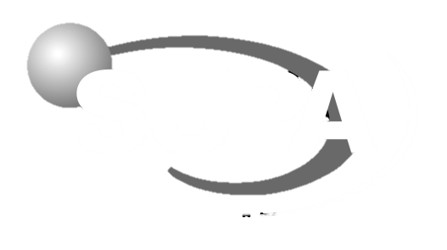
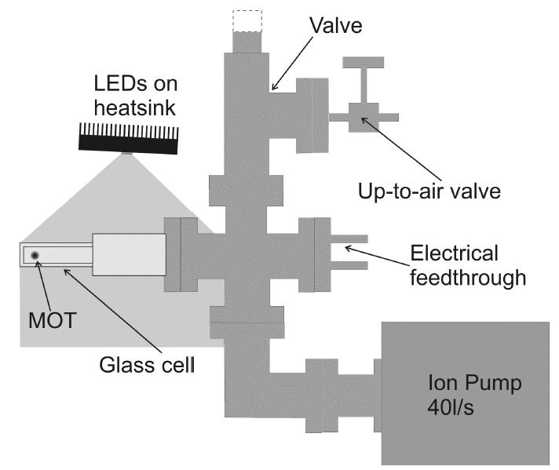
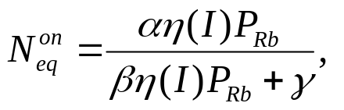
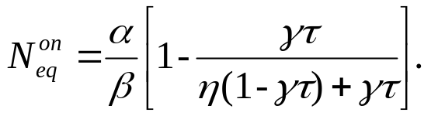
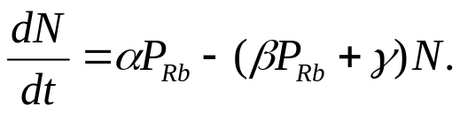
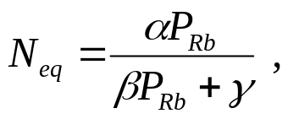
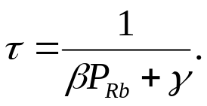
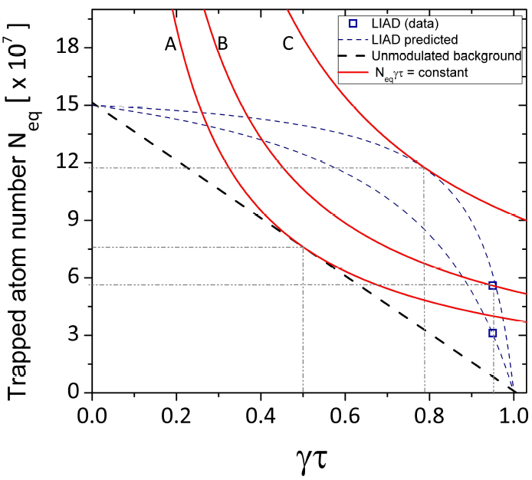
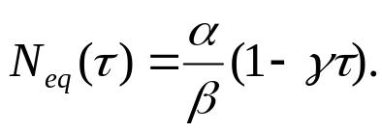
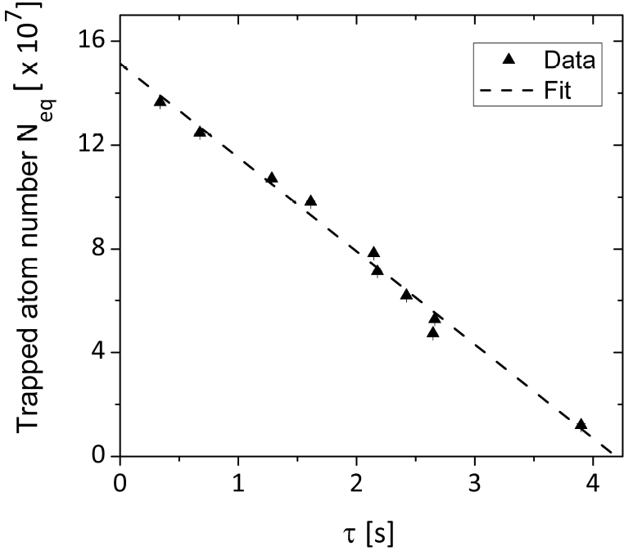
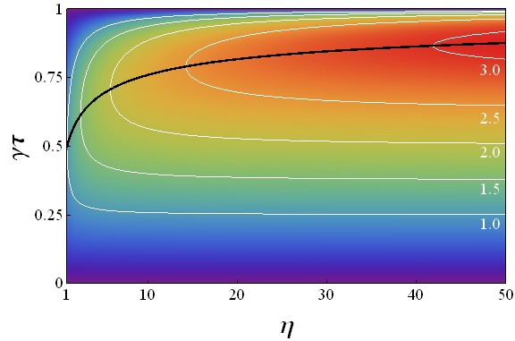
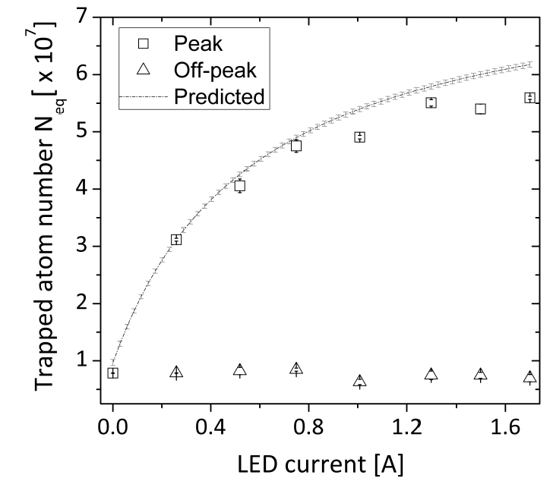
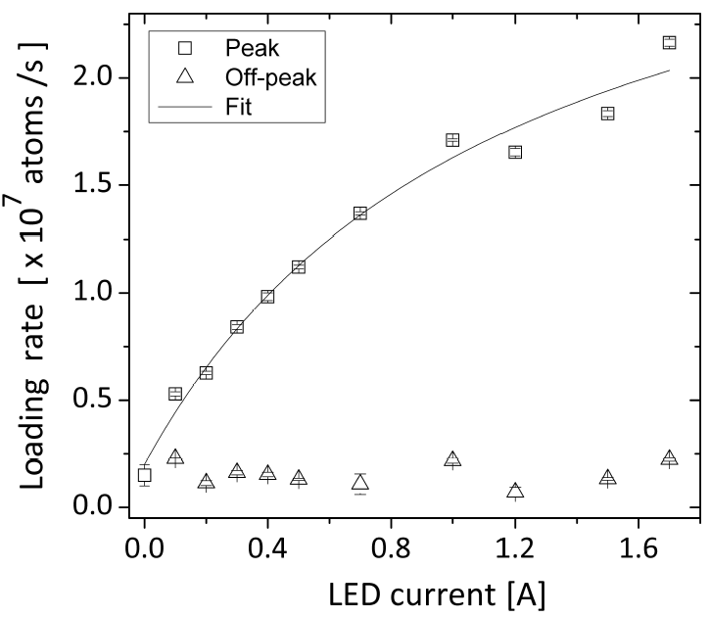



Light-induced atomic desorption
in a compact system for ultracold atoms
L. Torralbo-Campo, G. D. Bruce, G. Smirne and D. Cassettari
Cold Atoms Group, SUPA School of Physics and Astronomy,
University of St Andrews, North Haugh, St Andrews, Fife, KY16 9SS, UK
www.st-andrews.ac.uk/coldatoms
Experimental setup
LIAD figure of merit
Our Rb MOT is obtained in a glass cell. We observe light-induced atomic desorption [1] (LIAD) of rubidium atoms from the cell walls by illuminating them with violet LEDs (405nm, 5W). LIAD increases the rubidium background pressure in the cell, therefore increasing the atom number N_{eq} in the MOT.
Following Ref. [2], the figure of merit is defined as the increase of the product N_{eq} τ relative to the case of unmodulated Rb background pressure, i.e. to what extent the pressure modulation caused by LIAD increases the product between atom number and lifetime.
Given that we can increase the MOT atom number temporarily during an LED pulse and recover a low Rb pressure after the pulse, τ is still given by the equation for the unmodulated background case. N_{eq} is now the MOT atom number reached during the LED pulse:
where η(I) is the relative increase in Rb pressure for an LED current I, and P_{Rb} is the off-peak pressure. P_{Rb} can again be eliminated in order to express the atom number as a function of τ:
Therefore off-peak MOTs and LIAD-enhanced MOTs can be plotted on the same N_{eq}-τ plot, and the figure of merit quantified by hyperbolae defined as Ν_{eq}γτ=const. [3]:
N_{eq}-τ
plot with unmodulated background
The loading of atoms in a MOT from background gas is the result of the balance between the atom capture rate and the rate of loss mechanisms:
The trapped atom number at equilibrium and the 1/e loading time are given by:
It is convenient to eliminate the Rb pressure between these two equations and express the atom number as:
This dependence can be explored experimentally by acquiring MOT loading curves at different Rb pressures, i.e. for different values of τ:
The two experimental points are taken at different values of LED current, namely η=4.8 and 13. This analysis shows that for these values of η, the best figure of merit (hyperbola C) is achieved at γτ lower than what was used in our experiment.
In the following plot, the increase in Ν_{eq}γτ is shown as a function of η and γτ. This plot can be used as a guide for the best choice of γτ for any given value of η. In refs. [4,5], increases in Ν_{eq}γτ between 3 and 4 were observed, which are consistent with the values shown in the plot:
Physically the intercept with the vertical axis, α/β, represents the largest MOT achievable in our chamber in the limit of partial Rb pressure much larger than the residual background from other gases. The intercept with the horizontal axis 1/γ is the longest MOT lifetime achievable, which is determined by the residual background pressure. LED pulses will temporarily increase the partial Rb pressure, but they do not alter the parameters α/β and γ, which are therefore fixed and characteristic of our system. More specifically, α/β is determined by the available optical power in the cooling laser beams, while γ is given by the vacuum conditions.
LIAD-enhanced MOT
The two highlighted experimental points are those also reported on the figure-of-merit plot.
The loading rate, which is linearly proportional to Rb pressure, is used to extract η(I), which in turn is used
to calculate the predicted curves on the figure-of-merit plot.
[1] A. Gozzini et al., Il Nuovo Cimento D 15, 5, 709 (1993).
[2] B. P. Anderson and M. A. Kasevich, Phys. Rev. A 63, 023404 (2001).
[3] L. Torralbo-Campo et al., arXiv:1312.6442.
[4] G. Telles et al., Phys. Rev. A 81, 032710 (2010).
[5] E. Mimoun et al., Phys. Rev. A 81, 023631 (2010).

