Slide 1

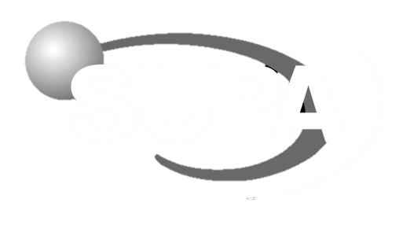
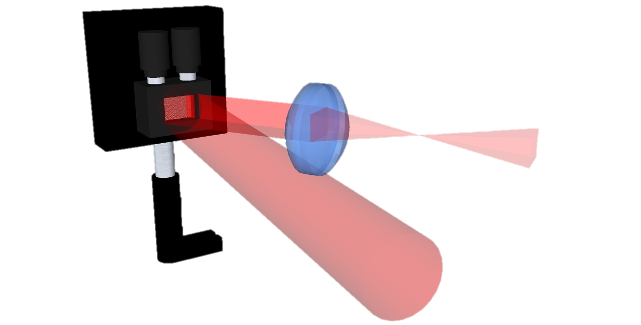
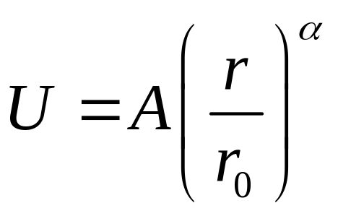
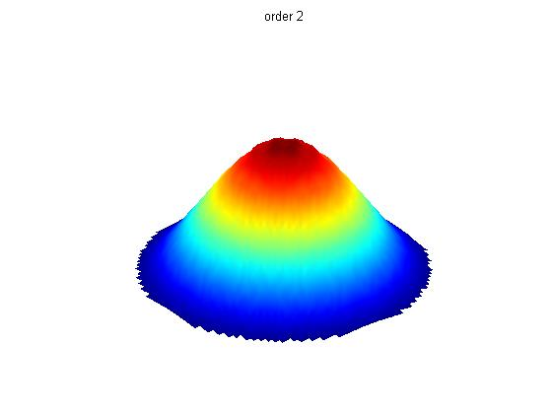
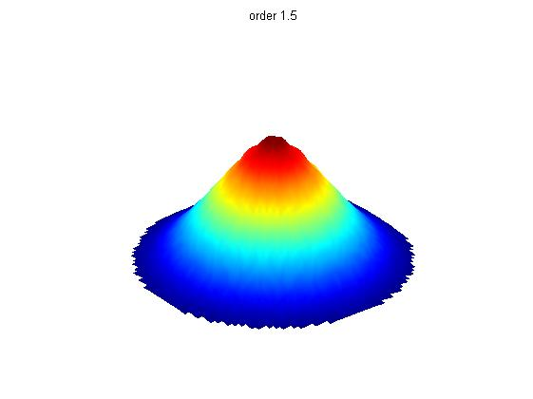
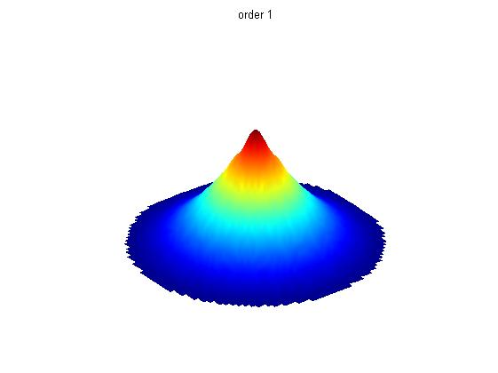
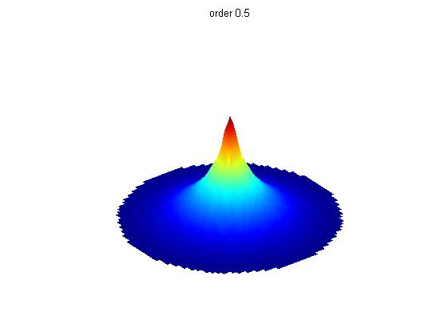
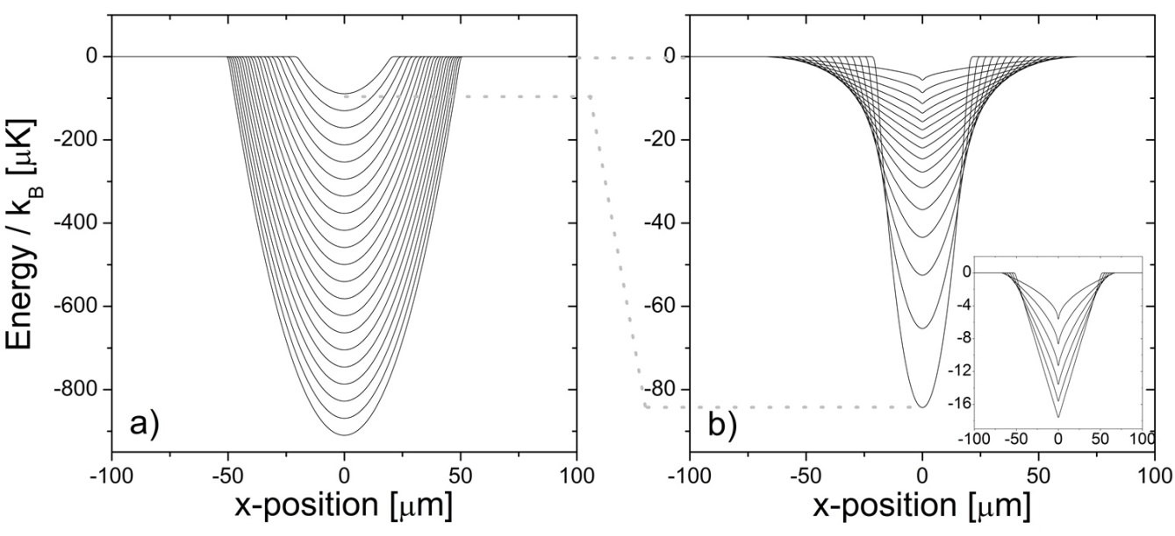
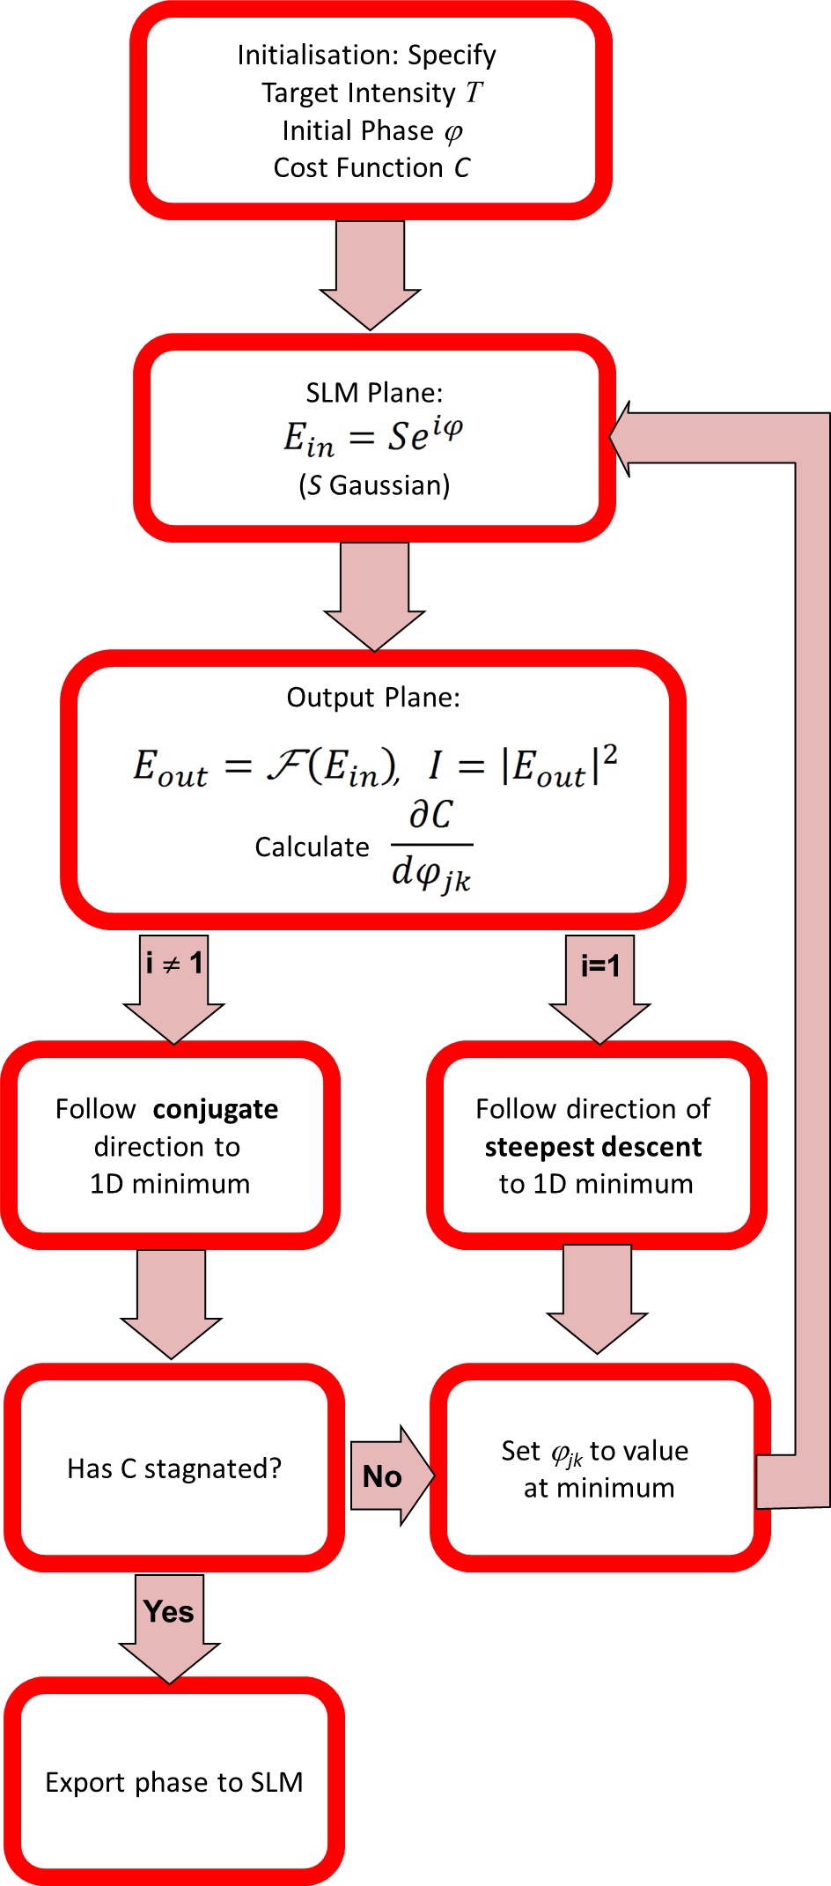
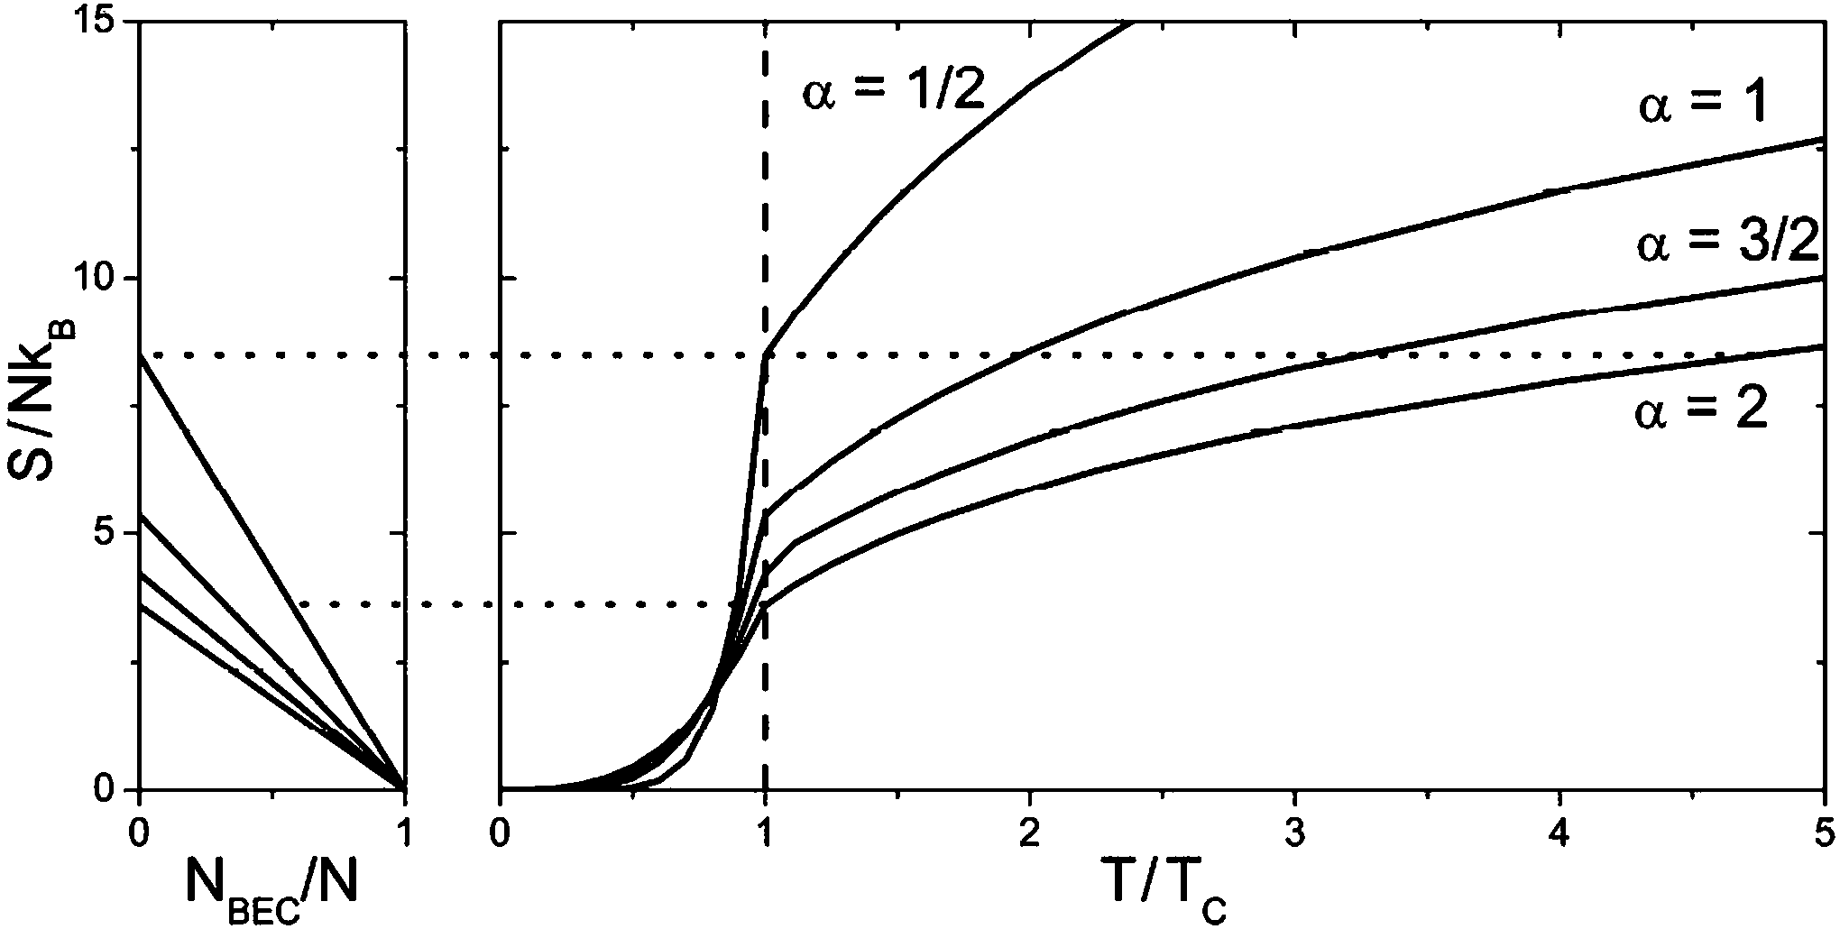
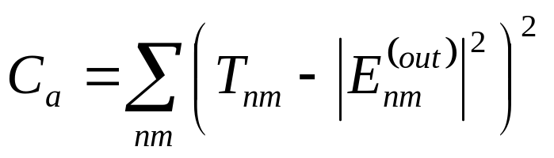

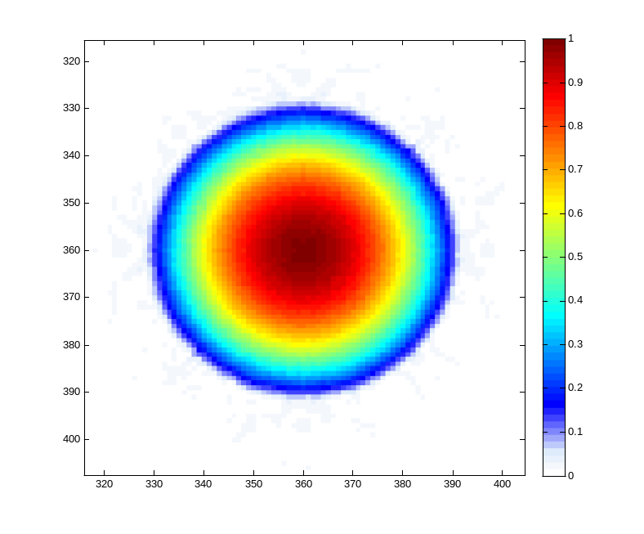
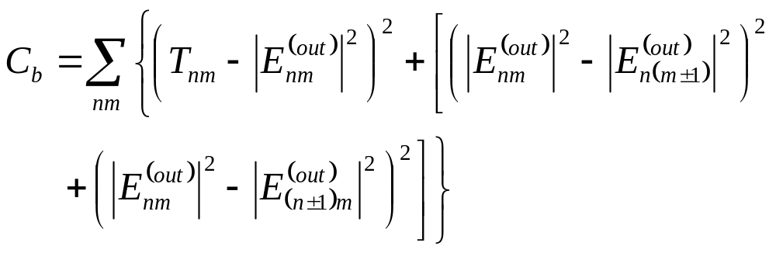
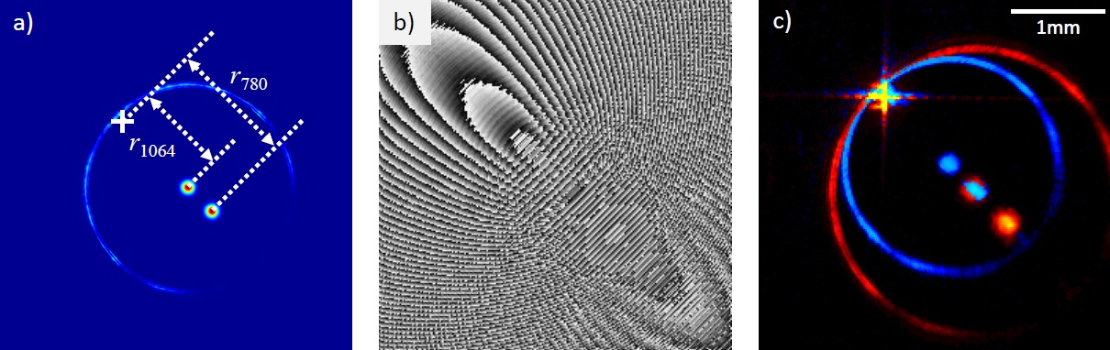
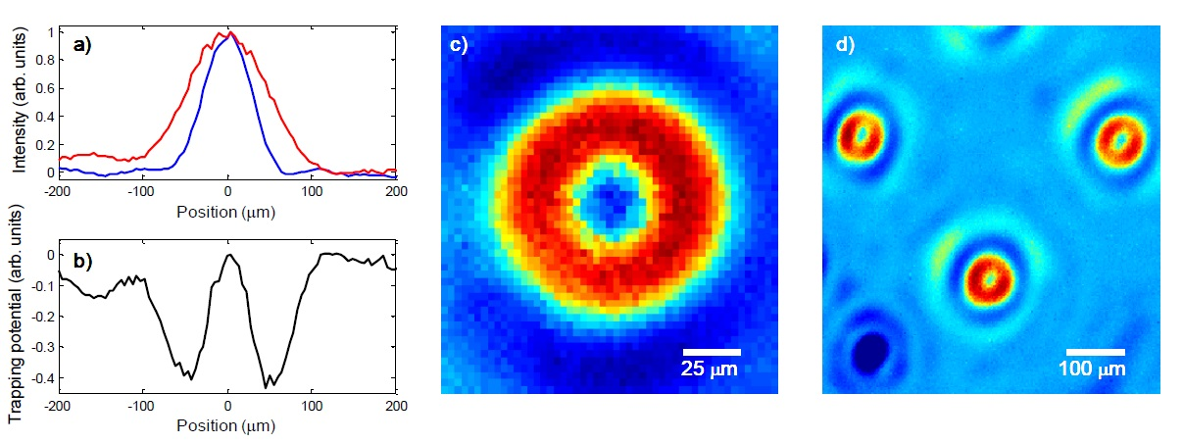
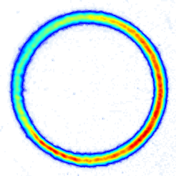
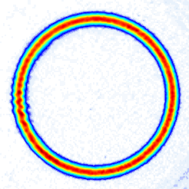
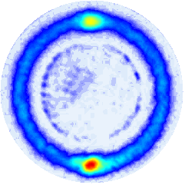
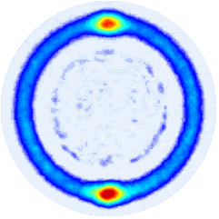
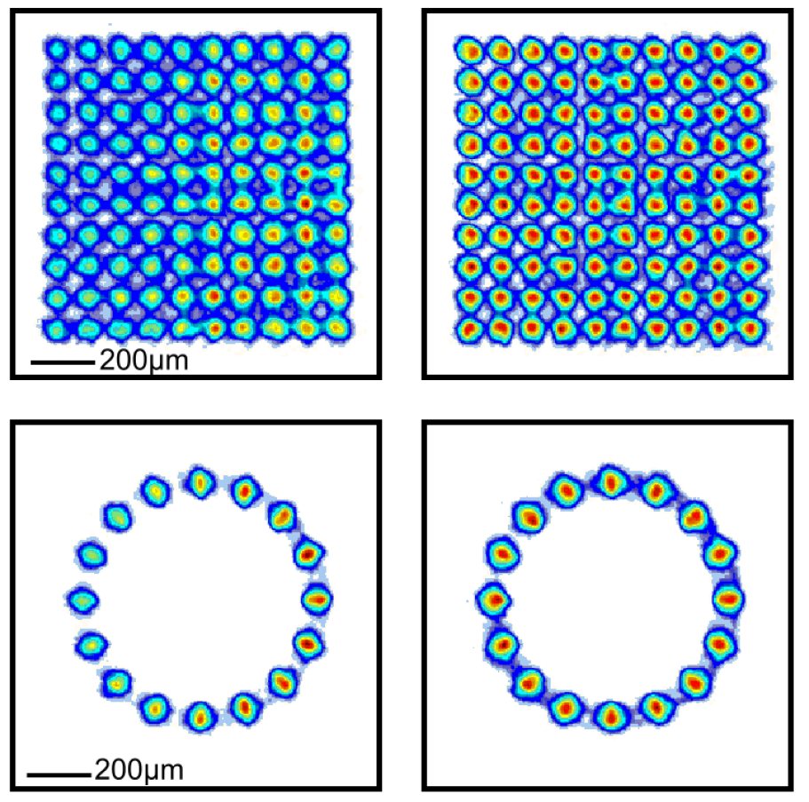
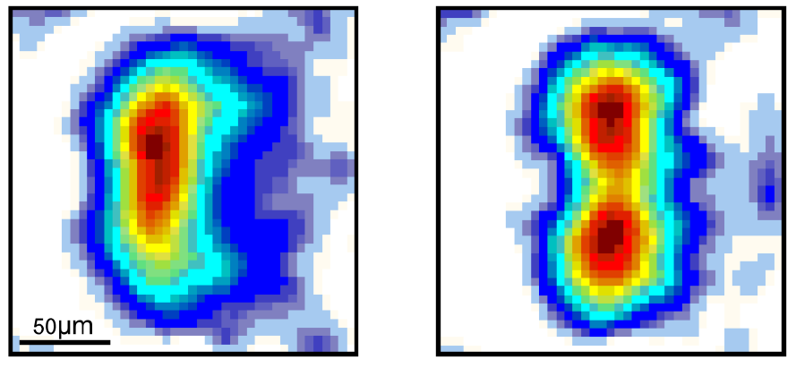
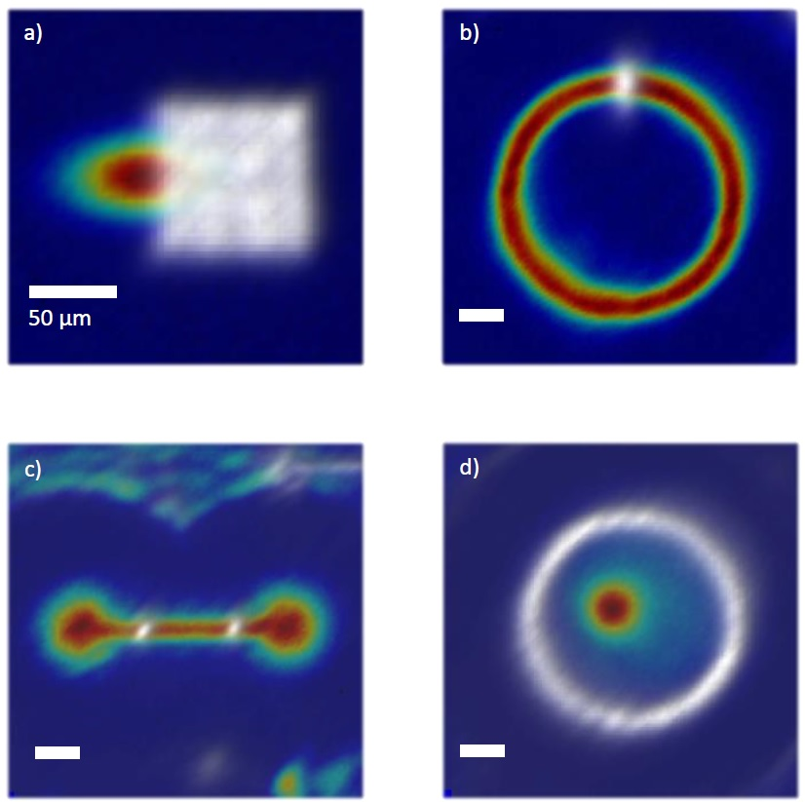
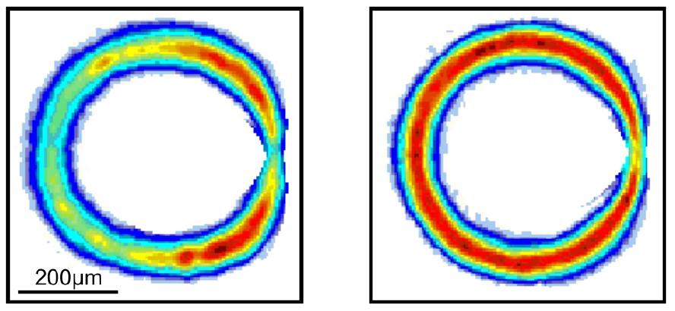
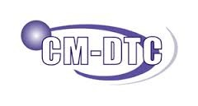



Phase-engineered Light Patterns for Ultracold Atom Experiments
G. D. Bruce, D. Bowman, T. Harte, M. Y. H. Johnson, P. Ireland,
E. Cormack, D. Richards, S. L. Bromley, J. Mayoh, J. Keeling, and D. Cassettari
Cold Atoms Group, SUPA School of Physics and Astronomy,
University of St Andrews, North Haugh, St Andrews, Fife, KY16 9SS, UK
www.st-andrews.ac.uk/coldatoms
Phase-Only Spatial Light Modulation
BEC in a Variable Power-law Trap
A phase-only Spatial Light Modulator (SLM) is a programmable diffractive optical device consisting of an array of pixels which individually impose a phase retardation onto an incident light beam. This phase-engineering generates desired intensity patterns in the far-field (usually realised with a system of lenses), which are given by the Fourier transform of the light field on the SLM.
ε(x) $∝$ F [ϕ (x)]
ϕ (x)
α = 2 1.5 1 0.5
We use our SLM to generate optical traps with intensity decaying as a power-law from a central maximum [4]. A sequence of these can be used as a time-dependent optical dipole trap for all-optical production of BECs in two stages.
Conjugate Gradient Optimisation
Calculating a phase pattern which produces the desired intensity distribution is not simple. Recently we have developed a new algorithm based on conjugate gradient optimisation [1]. In this computationally efficient, multidimensional function-minimisation technique, the phase pattern is labelled as a vector of 65536 dimensions (each corresponding to an individual SLM pixel).
Efficient evaporative cooling in a trap with adjustable strength and depth
Adiabatic transformation of trap order to cross the BEC transition reversibly.
A specified cost function measures the suitability of the hologram for atom trapping and can be defined to take account of any feature of interest. For example, when using the simplest cost function
Transform 1:
Evaporate to T~5T_{BE}, then adiabatically reach BEC transition
Transform 2:
Evaporate to T ~ T_{BE}, then adiabatically increase BEC fraction
Transform 1
Transform 2
to calculate power-law traps, the calculated output contains many optical vortices (Fig. a).
Both approaches give larger BECs than evaporation alone, and the adiabatic transform allows reversible crossings of the BEC transition
a)
b)
Multi-Wavelength Holography
By including cost function terms which smooth differences between neighbouring pixels, these vortices are removed (Fig. b).
Through recent work, we have also demonstrated a method of producing multi-wavelength light profiles using only one SLM [5].
Feedback Improved Output
As the light patterns are produced through diffraction off of the SLM, the size and position of the patterns will depend on the wavelength, much like the separation of spots from a diffraction grating. If the target intensity profile is chosen carefully, overlapped profiles of different wavelengths can be achieved.
By enclosing the hologram calculation in a feedback loop [2, 3], we have been able to smooth the relevant intensity profile to the percent level. The light is imaged using a CCD camera, and compared to the target. Any discrepancies are used to redefine the target for the next iteration of the calculation.
100µm
This concept can be used, for example, to create overlapped diffraction limited spots. If one spot has a wavelength larger than the resonant wavelength of an atom (red-detuned) and the other has a wavelength smaller than resonance (blue-detuned), the result will be a sub-diffraction limited ring trap. Due to the flexibility of the SLM, arrays of these ring traps can also be produced.
The method is not only limited to spots. We have also demonstrated more complex patterns using our feedback process. (The white image corresponds to blue-detuned light, whilst the colour image corresponds to red-detuned light.)
[1] T Harte et al., Opt. Express, 22, 26548 (2014)
[2] G D Bruce et al., arXiv:1409.3151
[3] G D Bruce et al., Phys. Scr. T143 014008 (2011)
[4] G D Bruce et al., Phys. Rev. A 84, 053410 (2011)
[5] D Bowman et al., arXiv:1501.01185 (2015) accepted for publication in Opt. Express

