Slide 1

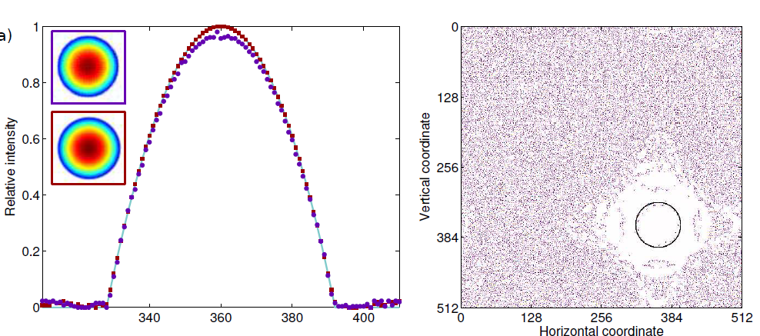

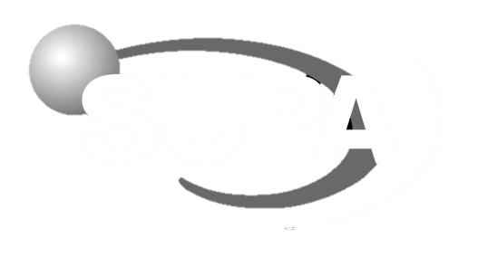

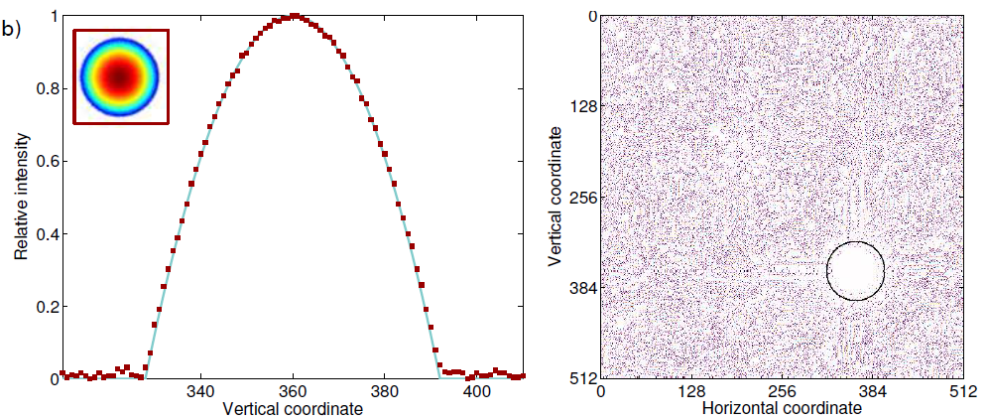
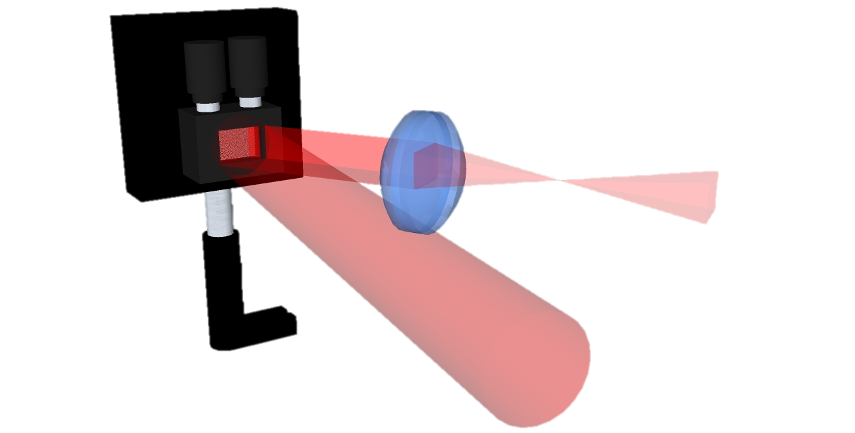
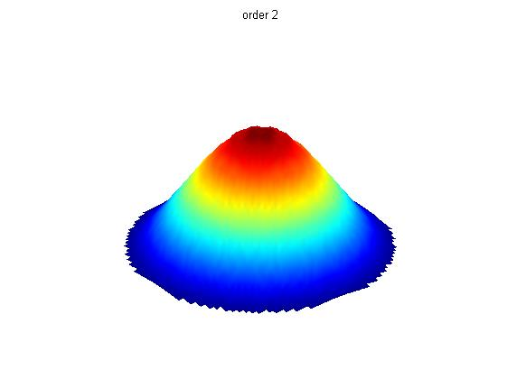
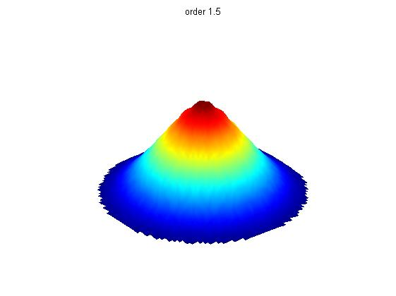
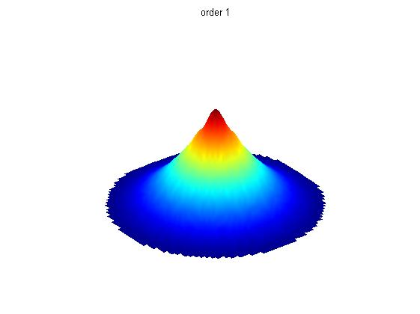
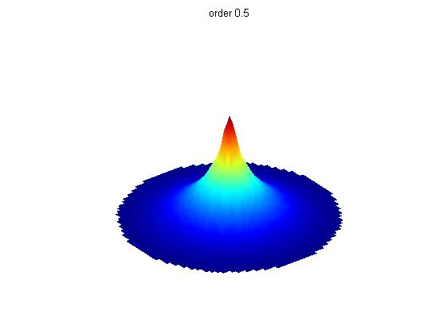
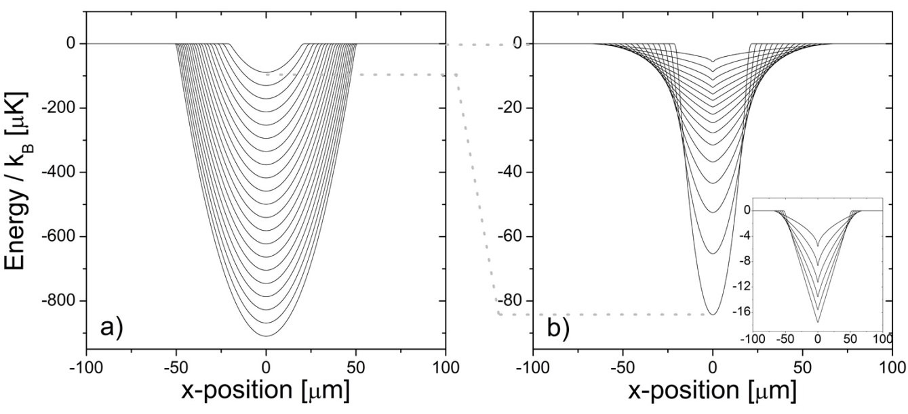
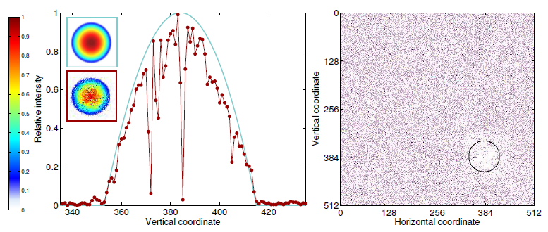
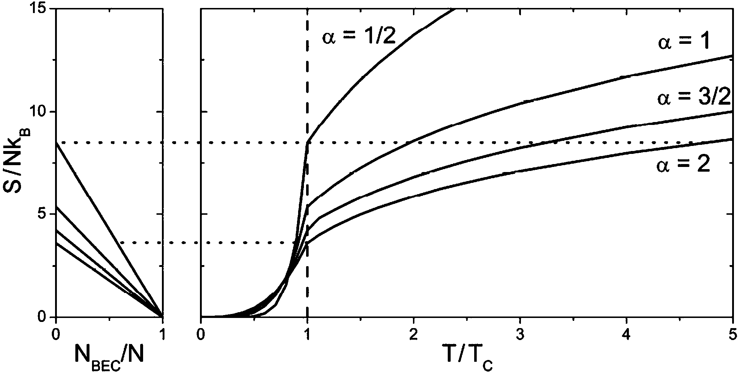

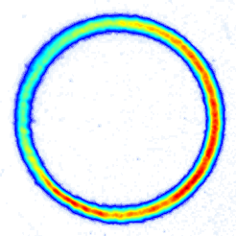
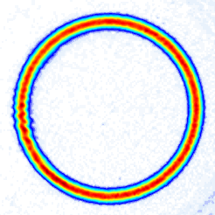
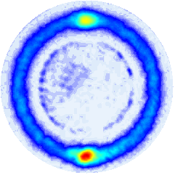
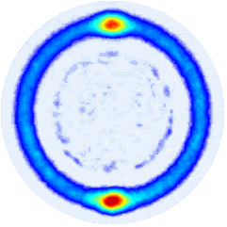


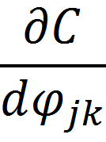

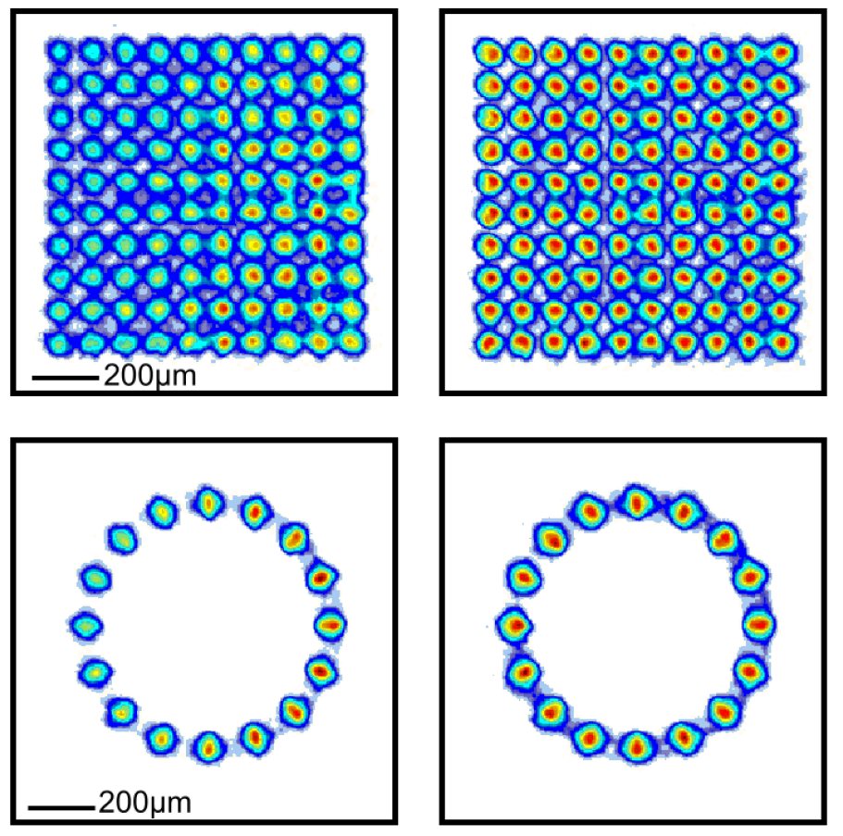
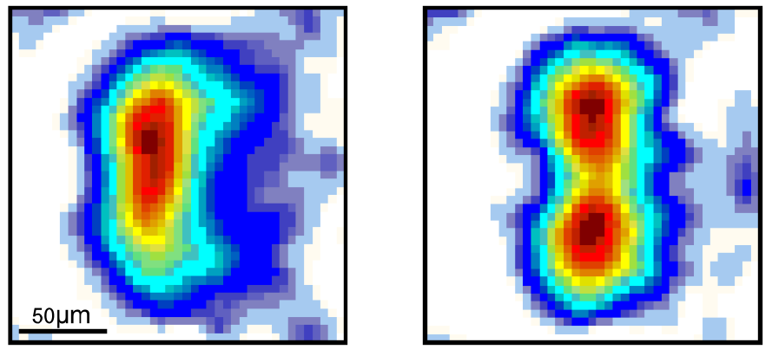
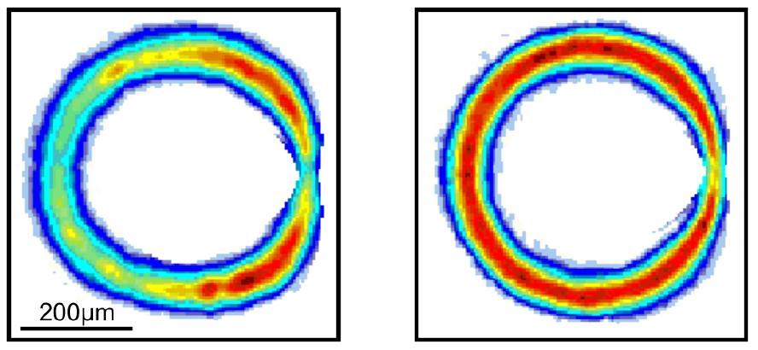

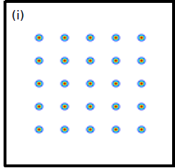
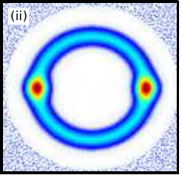




Holographic Optical Traps for Cold Atoms
G. D. Bruce, T. Harte, M. Y. H. Johnson, P. Ireland, D. Bowman
E. Cormack, D. Richards, S. L. Bromley, J. Mayoh, J. Keeling, and D. Cassettari
Cold Atoms Group, SUPA School of Physics and Astronomy,
University of St Andrews, North Haugh, St Andrews, Fife, KY16 9SS, UK
www.st-andrews.ac.uk/coldatoms
Phase-Only Spatial Light Modulation
BEC in a Variable Power-law Trap
ε(x) $∝$ F [ϕ (x)]
A Phase-Only Spatial Light Modulator (SLM) is a programmable diffractive optical device which consists of an array of pixels, each of which is individually controllable and imposes a phase retardation onto an incident light beam. This phase-engineering is used to generate intensity patterns of interest in the far-field (usually realised with a system of lenses), which are given
ϕ (x)
α = 2 1.5 1 0.5
We use our SLM to generate optical traps with intensity decaying as a power-law from a central maximum [4]. A sequence of these can be used as a time-dependent optical dipole trap for all-optical production of BECs in two stages.
by the Fourier transform of the light field on the SLM. These light fields can then be used to generate arbitrarily-shaped optical traps for cold atoms. By displaying a sequence of phase patterns on the SLM, dynamic optical traps can also be generated. We use a reflective SLM with 256 x 256 pixels, each of which can take one of 256 values between 0 and 2π.
Iterative Fourier Transform Algorithm with Feedback
Efficient evaporative cooling in a trap with adjustable strength and depth
Adiabatic transformation of trap order to cross the BEC transition reversibly.
Calculating a phase pattern which produces the desired intensity distribution is not simple, but can be performed using an Iterative Fourier Transform Algorithm, such as the Mixed-Region Amplitude Freedom method [1] which divides the output plane into signal and noise regions.
The amplitude of the light in the signal region (the pattern of interest plus a border which will be devoid of light) is fixed relative to the target, and all “noise” on the pattern is moved to the noise region, where the light pattern is unconstrained. This separation should ensure atoms do not become trapped in the noise. The algorithm calculates smooth light patterns, but aberrations introduced by the optical setup and imperfect
Completed
Yes
Accurate?
Image intensity in Fourier plane
with CCD
Transform 1:
Evaporate to T~5T_{BE}, then adiabatically reach BEC transition
Transform 2:
Evaporate to T ~ T_{BE}, then adiabatically increase BEC fraction
Transform 1
No
Transform 2
Specify Target Intensity.
Guess phase.
No
Export phase to SLM
Both approaches give larger BECs than evaporation alone, and the adiabatic transform allows reversible crossings of the BEC transition
Yes
Improved accuracy since last iteration?
Conjugate Gradient Optimisation
Intensity given by input beam profile.
Retained phase
SLM Plane
Calculated field.
Intensity probably wrong
We have recently developed a new algorithm to give an improved, high degree of control over the hologram calculation progress, based on conjugate gradient optimisation [5]. In this computationally efficient, multidimensional function minimisation technique, the phase pattern is labelled as a vector of 65536 dimensions (each corresponding to an individual pixel).
Fourier
Transf.
Inverse
Fourier
Transf.
A cost function is specified to measure the suitability of the hologram for atom trapping by comparing the Fourier transform of our phase grating to our target pattern. The cost function can be defined to take account of any feature of interest. For example, when using the simplest cost function
 | ε^{(10%)} [%]
Pattern | Before | After | Eff. [%]
Indented Ring | 9.8 | 2.1 | 21.5
Double Well | 5.5 | 0.7 | 20.0
Square Lattice | 3.6 | 2.3 | 14.8
Ring Lattice | 2.5 | 1.1 | 17.5
Calculated field.
Intensity probably wrong
Replace
intensity
Some field, with acceptable intensity
Initialisation: Specify
Target Intensity T
Initial Phase ϕ
Cost Function C
Output Plane
SLM response limit the suitability of the patterns for optical trapping.
By enclosing the MRAF algorithm in a feedback loop [2, 3], we have been able to smooth the intensity profile at the trap location to the percent level. The light is imaged using a CCD camera, and compared to the target. Any discrepancies are used to redefine the target for the next iteration of the IFTA.
SLM Plane:
(S Gaussian)
Output Plane:
,
Calculate
to calculate power-law traps, the calculated output contains many optical vortices.
100µm
i ≠ 1
i=1
Follow conjugate
direction to
1D minimum
Follow direction of
steepest descent
to 1D minimum
By including cost function terms which smooth differences between neighbouring pixels, these vortices are removed.
Has C stagnated?
No
Set ϕ_{jk} to value
at minimum
Yes
Export phase to SLM
[1] M Pasienski and B DeMarco, Opt. Express 16, 2176–2190 (2008)
[2] G D Bruce, et al., arXiv:1409.3151
[3] G D Bruce, et al., Phys. Scr. T143 014008 (2011)
[4] G D Bruce, et al., Phys. Rev. A 84, 053410 (2011)
[5] T Harte, et al., accepted in Opt. Express, arXiv:1408.0188

