Slide 1


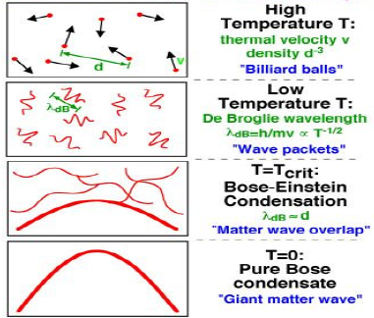
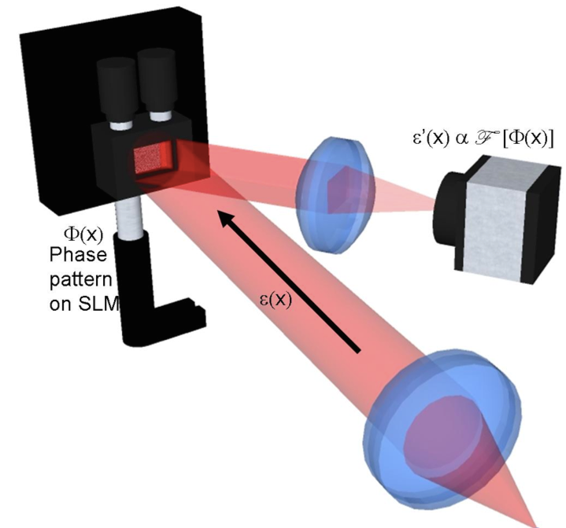
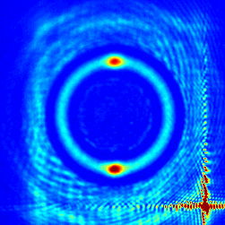
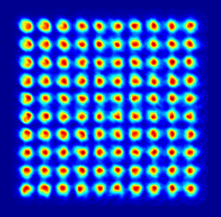
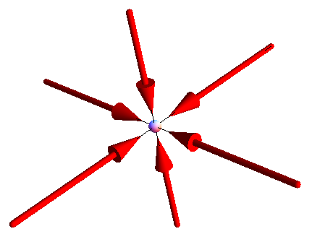

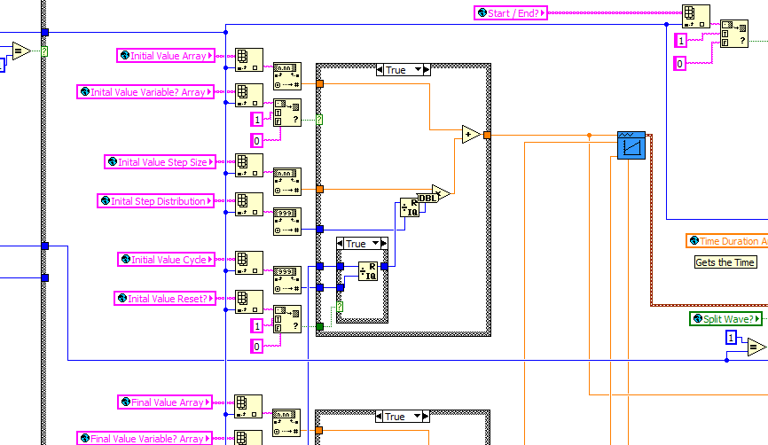
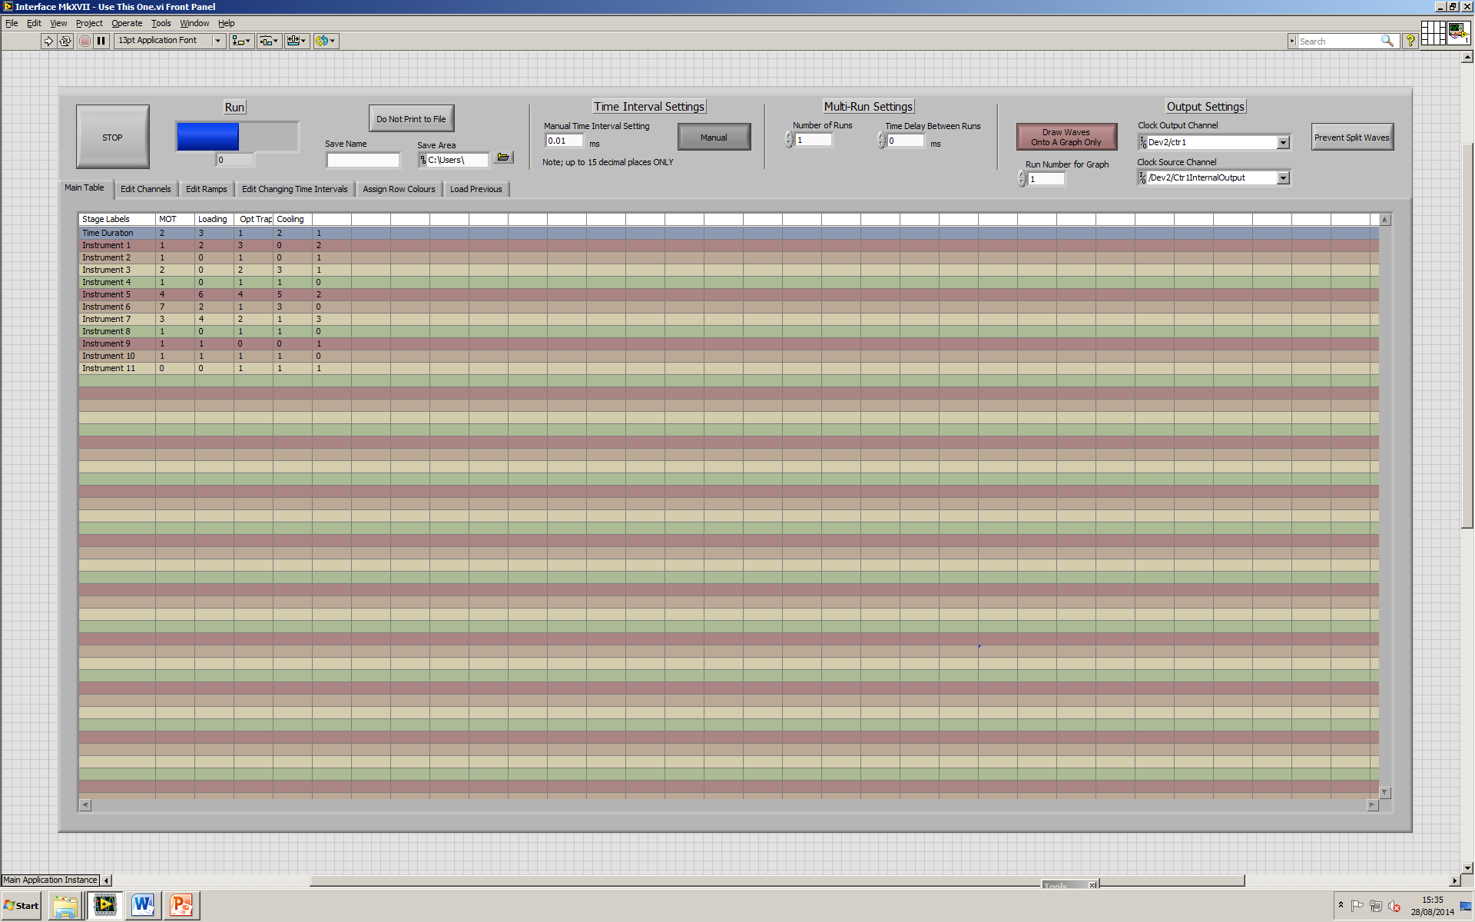



A New Computer Control Suite for
Ultracold Atom Experiments
T. Ackernley, D. Bowman, G. D. Bruce and D. Cassettari
Cold Atoms Group, SUPA School of Physics and Astronomy,
University of St Andrews, North Haugh, St Andrews, Fife, KY16 9SS, UK
www.st-andrews.ac.uk/coldatoms
The Bose-Einstein Condensate
In quantum physics, particles can be considered as waves instead of the traditional point-mass representation. A Bose-Einstein Condensate, or BEC, can arise when a macroscopic fraction of the particles in the ensemble are in their ground state. In such circumstances the wavefunctions of these particles overlap to form a single matter wave. One field of physics where this is seen in the lab is atomic physics, where bosonic atoms can be made to undergo this transition. While it is theoretically possible to form a BEC using pressure, doing so causes particles to combine into molecules or be lost in collisions, so instead an approach centred on cooling atoms in low pressure is used.
Arbitrarily shaped optical traps
A key feature of our experiment will be the optical trap used to hold the BEC. By using a Spatial Light Modulator (SLM) to control the laser incident on the atoms, traps can be made in flexible shapes. By imparting a spatially-varying phase on a laser beam, and passing this beam through a lens, an interference pattern can be created which is the Fourier transform of the phase distribution. The phase pattern can be changed remotely by computer allowing dynamic trap shapes which change with time.
By intersecting this post-SLM laser beam with a two-dimensional light sheet, a flat three-dimensional trap shape can be formed. Thus the BEC can be placed in many desirable shapes, such as rings or grids, for experimentation.
W. Ketterle, D. S. Durfee, and D. M. Stamper-Kurn, "Making, probing and understanding Bose-Einstein Condensates", Proceedings of the International School of Physics "Enrico Fermi", Course CXL, edited by M. Inguscio, S. Stringari, and C. E. Wieman (IOS Press, Amsterdam, 1999) pp. 67-176
Generating a BEC
The creation of a BEC involves cooling atoms to near zero temperatures. To avoid unwanted collisions the gas is held inside a vacuum chamber throughout.
Laser cooling can only cool so far. The atoms are transferred to a purely magnetic trap with no lasers to perform evaporative cooling. Here the energy required for particles to leave is lowered slowly, allowing warmer particles to leave, or ‘evaporate’, away from the gas. These remove more than their fair share of energy, greatly reducing the average temperature. However the number of particles left is far lower, typically around 10⁵.
Finally the atoms can be placed into an Optical Dipole Trap formed from far red-detuned light, which traps atoms in the areas of highest intensity. A multitude of different experiments can now be performed using the quantum gas.
Initial cooling is performed using lasers. If a laser beam has a frequency which is lower than (red-detuned) the atomic transition, but the atom moves towards the light, the Doppler effect makes the photon energy seem higher in the atom’s frame of reference, and it is therefore absorbed.
Cooling your tea works by a similar method, the warmer water evaporates off taking more than the average energy with it (although in this example we retain most of the tea).
Computer Control
While the initial MOT stage can take a relatively long time (~30s), the remaining stages operate on millisecond (or even microsecond) time scales. Most equipment is controlled using two National Instruments Data Acquisition cards, which receive control parameters from a computer.
On the computer the main interface is built using LabView, a graphics based programming language that works by flowing information along ‘wires’ visually connected between ‘function blocks’ in a form of left to right flowchart.
In order to create a more user-friendly programming experience, we have developed an interface which allows the user to program the experiming with a table structure. Each row corresponds to an instrument and each column a step in the experiment (which can have variable timings.) The entries into this table are the values to be written to the physical devices. Behind the scenes this information is calibrated to control voltages, turned into waveforms for each channel and written to the cards.
Data taken during an experiment is fed into a suite of software which generates a visual representation in near real time. This allows the user to observe series of experiments as they progress to monitor the requirements for the next experiments.
The atom then emits a photon which is exactly resonant with the transition, i.e. has more energy than the absorbed photon. This excess of energy in the emitted photon reduces the kinetic energy of the atom. The extension of this scheme to three pairs of mutually-orthogonal laser beams, with a guiding magnetic field, is called a Magneto-Optical Trap, and can typically capture 10⁹ atoms.
Computer Control
While the initial MOT stage can take a relatively long time (~30s), the remaining stages operate on millisecond (or even microsecond) time scales, and the channels must be precisely synchronised. For this reason, most equipment is controlled using two National Instruments Data Acquisition cards, which receive control parameters from a computer.
On the computer, the main interface is built using LabView, a graphics based programming language that works by flowing information along ‘wires’ visually connected between ‘function blocks’ in a form of left to right flowchart.
In order to create a more user-friendly programming experience, we have developed an interface which allows the user to program the experiment within a table structure. Each row corresponds to an instrument and each column a step in the experiment (which have variable timings.) The entries of this table are the values which are written to the physical devices.
Data taken during an experiment is fed into a suite of software which generates a visual representation in near real time. This allows the user to observe series of experiments as they progress to monitor the requirements for the next experiments.

